Slide 1

3rd TFTEI Annual Meeting Rome, October, 20, 2017
Emission and pollution trends of BaP (1990-2015), contribution of main source categories with emphasis on domestic combustion
Sergey Dutchak
EMEP/Meteorological Synthesizing Centre - EAST

Slide 2
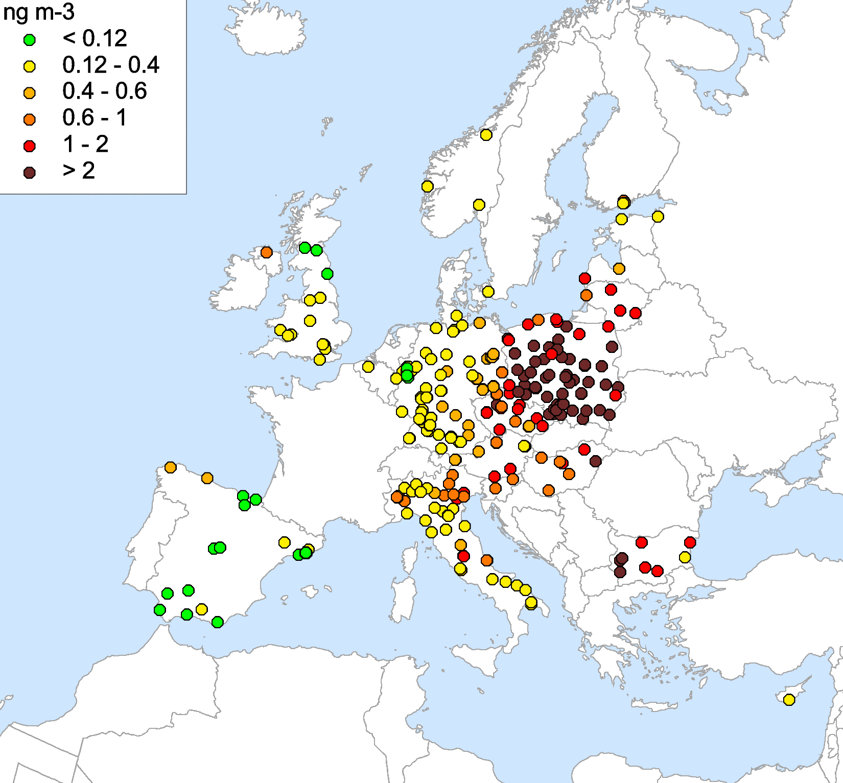
Pollution trends of BaP in the EMEP region (2005-2015)
Protocol on POPs
Article 9 REPORTING
EMEP shall provide information on the long-range transport and deposition of persistent organic pollutants
2.5
2.0
1.5
BaP in air, ng/m³
1.0
EU target level
EU target level
0.5
0.0
2005
2006
2007
2008
2009
2010
2011
2012
2013
2014
Mean levels of BaP in air measured at background, suburban, and urban sites
EEA AirBase measurements of BaP
At 35% of stations annual mean BaP air concentrations were
above the EU target level 1 ng/m³

Slide 3
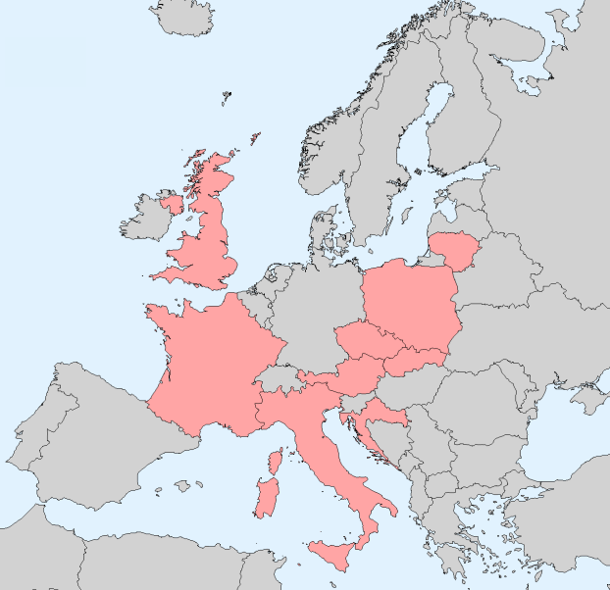
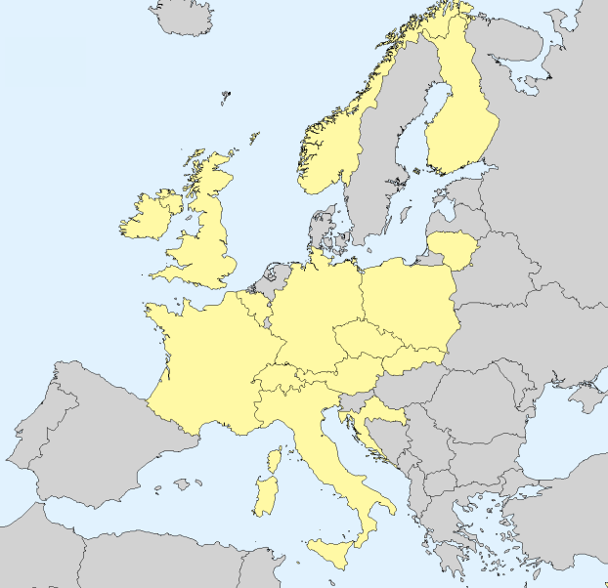
Exceedancies of BaP air quality standards
POP Protocol
Article 8 RESEARCH, DEVELOPMENT AND MONITORING
(f) An effects-based approach which integrates appropriate information … on measured or modelled environmental levels, pathways, and effects on human health and the environment, for the purpose of formulating future control strategies …
EU
WHO
Exceedance of EU target level 1 ng/m³ - 9 countries (AirBase, 2015)
Exceedance of WHO reference level
0.12 ng/m³ - 16 countries (AirBase, 2015)
Notes:
If we compare these levels of concentrations in 2015 with air quality standards, we can see that in case of EU target level exceedancies can be seen in 9 countries at about 80 monitoring sites.
In case of WHO reference level, which is much lower, exceedancies are seen in 16 countries at about 300 monitoring sites.
Along with that significant levels of BaP and exceedancies can also take place in other countries that are not covered by measurements, for example, in eastern and southern Europe.
In this context, the conclusion made by the previous session about exposure of population might hide the extent of the problem. Important issue here is chemical composition of PM emitted from biomass burning. As we have seen from the results of AirUse for Life project, emitted particulate matter contains not only BaP, but also many other toxic substances like other carcinogenic PAHs, dioxins and furans, and HMs that just increase adverse effects.
So this needs more significant attention and further work on evaluation of exposure to toxic compounds in co-operation with WGE and TF on Health.

Slide 4
Protocol requirements for emission data
Protocol on POPs
Article 9 - REPORTING
Each Party within the geographical scope of EMEP shall report . . . information on the levels of emissions of persistent organic pollutants."
ANNEX III
SUBSTANCES REFERRED TO IN ARTICLE 3
Polycyclic aromatic hydrocarbons (PAHs): For the purposes of emission inventories,
the following four indicator compounds shall be used: benzo(a)pyrene, benzo(b)fluoranthene, benzo(k)fluoranthene, and indeno(1,2,3-cd)pyrene.
ANNEX V
Major stationary sources of PAH emissions:
Domestic wood and coal heating (Residential combustion)
Open fires such as refuse burning, forest fires and after-crop burning
- Coke and anode production
- Aluminium production
- Wood preservation installations

Slide 5
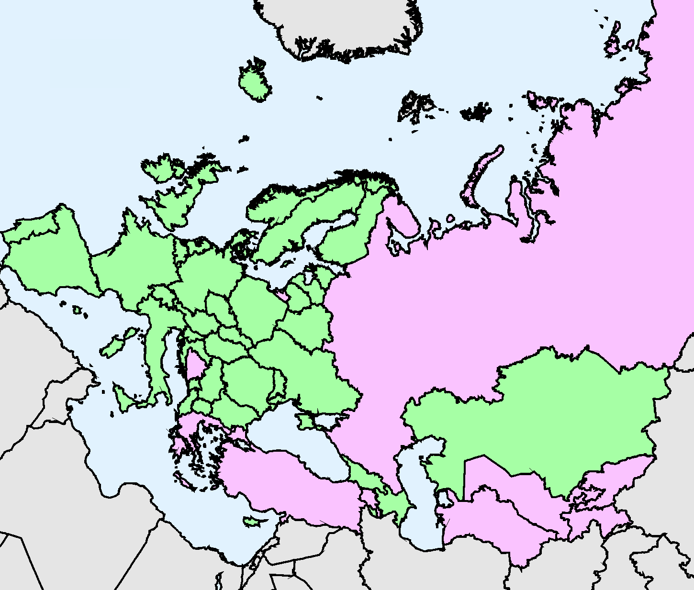
Available BaP emission data (2005-2015)
Protocol on POPs Article 9 - REPORTING
Each Party within the geographical scope of EMEP shall report . . . information on the levels of emissions of persistent organic pollutants."
Required emission parameters:
Gridded emissions (0.1º x 0.1º)
Seasonal variations
Vertical distribution
Global emissions
Official emission data
0.4
²/day
g/m
0.3
μ
0.2
Emissions, ,
0.1
Sectoral emission data - 42 countries
0.0
Jan
Feb
Mar
Apr
May
Jun
Jul
Aug
Sep
Oct
Nov
Dec
No data - 9 countries
Seasonal variation of BaP emissions

Slide 6
PAH (BaP) emissions from main source categories
in the most of EMEP countries
PAH emissions by sectors
t/y
%
Other
82%
Other
Residential combustion
Residential combustion
Residential combustion – the largest contributor of PAH emissions (> 70%)
Emissions of residential combustion are almost stable during the last decade (2005-2015)
Notes:
Furthermore, five countries, namely, DE, PL, IT, RO, and HU, provide in total about 65-70% of these emissions.
And in 4 of them level of emissions in 2015 is higher than in the beginning of this period 2005-2015.

Slide 7
BaP emissions from different source categories
Fraction of emissions from residential combustion, 2015
Countries | BaP, %
Belgium | 87
Czech Republic | 97
Germany | 97
Hungary | 97
Poland | 80
United Kingdom | 90
…. | ~ 70
France
Norway
Spain
Agriculture
Residential combustion
Industry

Slide 8
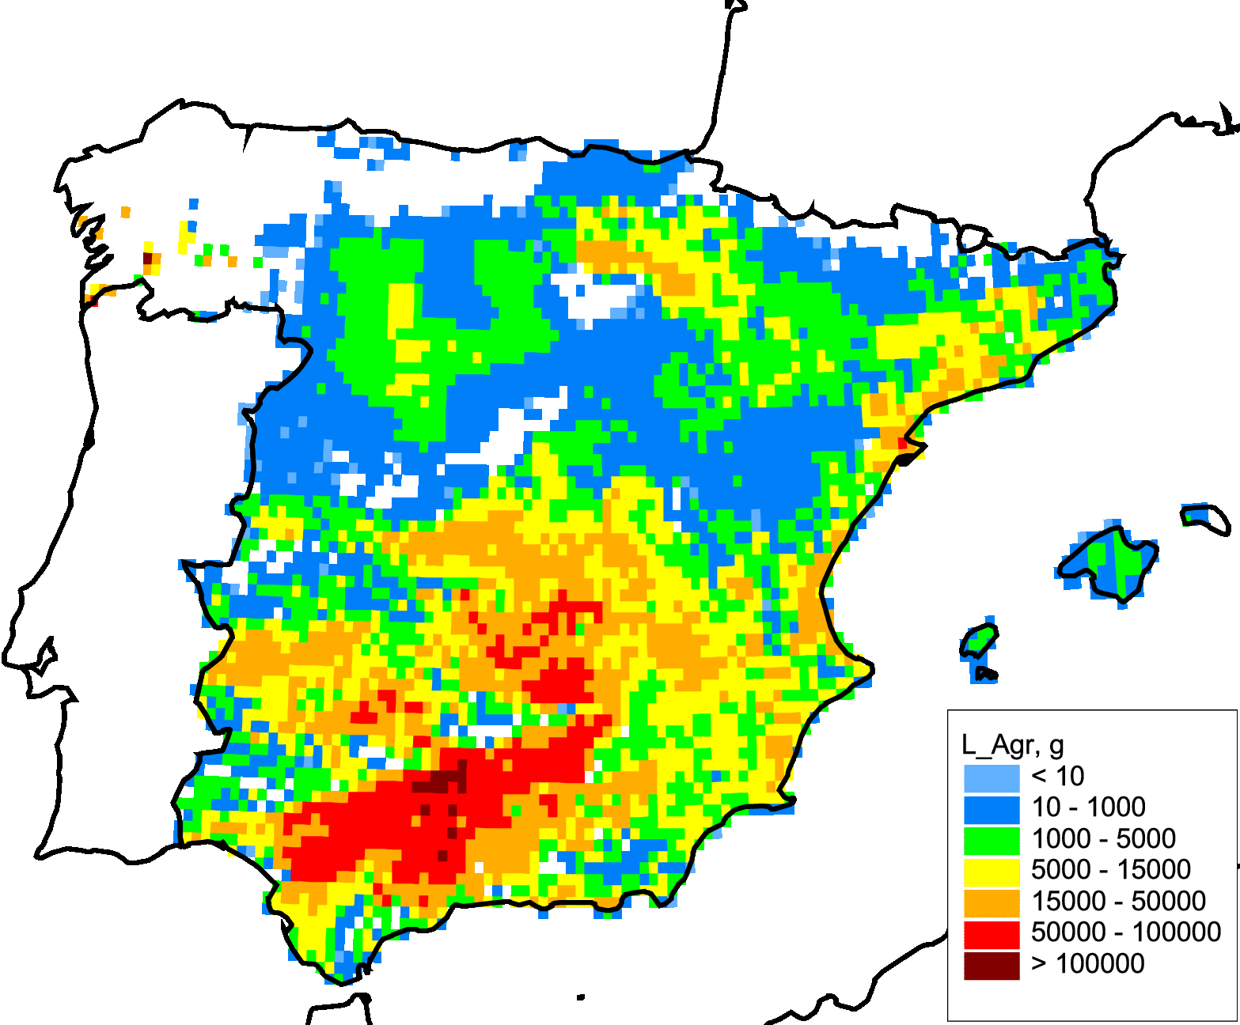
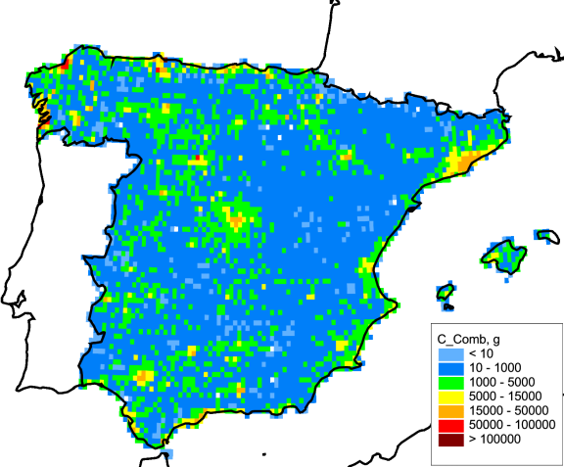
Peculiarities of PAH (BaP) emissions in Spain:
recent inventories - 2017
Agriculture
Residential
combustion
80
60
Emissions, %
EMEP
40
Spain
20
0
Residential
combustion
Agriculture
Other

Slide 9
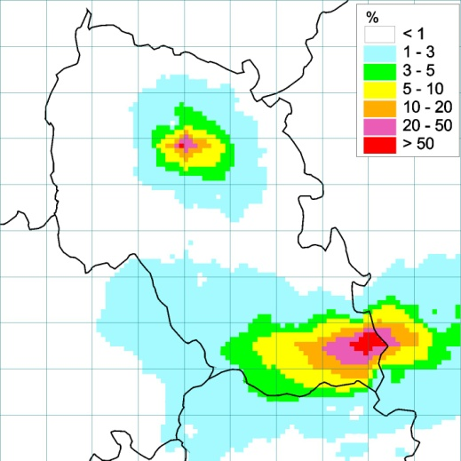
Pollution of cities by BaP from different source categories – Czech Republic
Main sector of BaP emissions in Czech Republic – Residential combustion (97 %)
Road
transport
7.4 %
Industry
0.8%
Prague
Residential
combustion
91.8%
Ostrava
Residential
combustion
3.7%
Road
transport
0.3 %
BaP air concentrations
Industry
96.0 %
BaP emission from sectors

Slide 10
Residential combustion
Source: ETC/ACM Technical Paper 2015/1

Slide 11
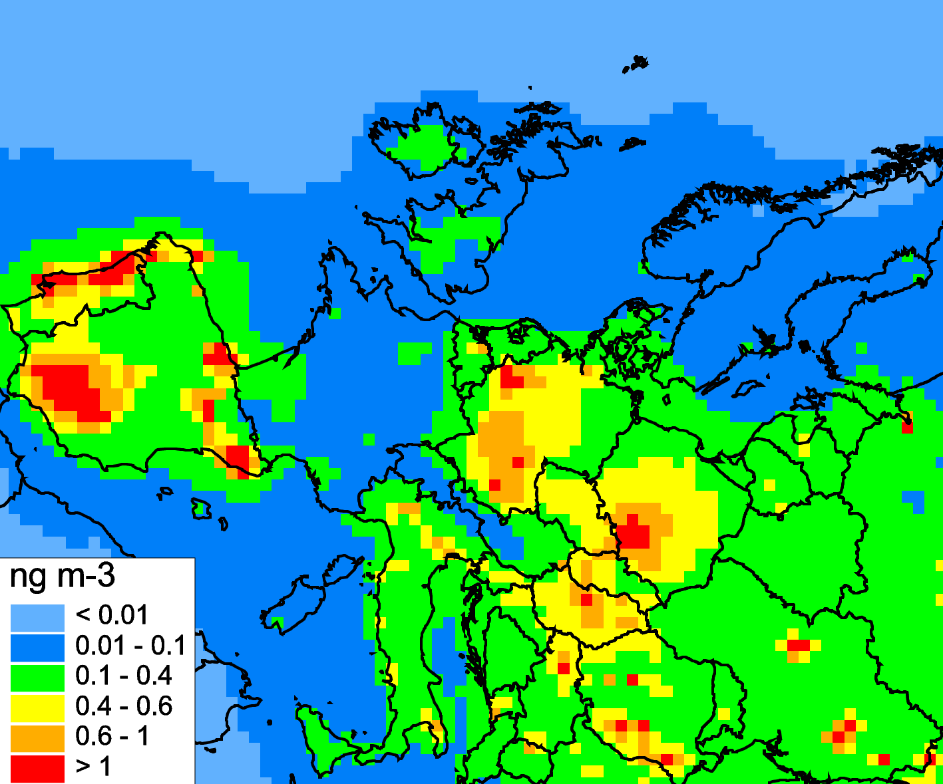
Uncertainties of emission data
BaP pollution in the EMEP countries:
discrepancies between modelling and measurements
Overprediction
Underprediction
3
3
Obs
3
Obs
3
Mod
Mod
2
2
BaP in air, ng/m
BaP in air, ng/m
1
1
0
0
Spain
Germany
Modelling results for 2015
France
Poland
Germany: “the PAHs emissions in the inventory are likely to be overestimated”
(DE IIR, 2017)
”Underestimation of BaP emissions of France”
CHIMERE modelling study (Florian Couvidat, TFMM meeting, 2017)

Slide 12
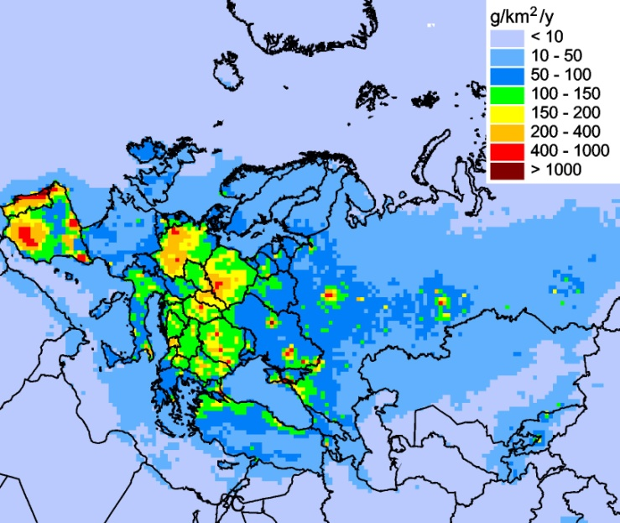
Transboundary transport of PAH pollution
PAH deposition to EMEP countries
Transboundary
transport
National emissions
PAH deposition in 2015
For about 70% of the countries contribution of transboundary fluxes exceeded contribution of national emissions to deposition

Slide 13
Future emission activities
Report Air quality in Europe – 2016
3.2 Air pollutant emissions from residential combustion
In European emission inventories, combustion of fuels within the residential sector is the major source of primary PM2.5 and PM10, as well as BC and BaP emissions, contributing 56 %, 40 %, 46 % and 71 % to emissions, respectively.
Integrated Assessment of Black Carbon and Tropospheric Ozone,
UNEP and WMO 2011
Key findings (emission projections up to 2030)
Without implementation of measures beyond current and planned regulations, emissions of BC, OC and carbon monoxide (CO) are projected to remain relatively constant to 2030.
Emissions from residential biomass combustion are expected to become even more important in the future than they are today.

Slide 14
Remarks
Protocol on POPs came into force in 2003, but levels of pollution by
BaP are still higher than EU target value in many countries
About 35% of sites showed increasing concentrations in period 2005-2015
(> 300 sites)
Protocol on POPs - Article 10
3. The Parties shall …. review the sufficiency and effectiveness of the obligations set out in the present Protocol. Such reviews will take into account the best available scientific information on the effects of the deposition of persistent organic pollutants, … and the fulfillment of the obligations on emission levels.

Slide 15
Future work
Report of the ad‐hoc Policy Review Group of experts (WGSR)
B. Maximizing the impact of the Convention and its Protocols
Updating the amended Protocols (POPs …):
Task Force on Techno-economic Issues (TFTEI) explore to what extent the Protocol on POPs could be further developed with respect to UPOPs, especially on PAHs, and explore whether and which stricter measures could be recommended for the UNECE region
Draft 2018–2019 workplan (Steering Body to the EMEP)
1.1.3.1 Analysis of effectiveness of implementation of Protocol on POPs | Contribution to evaluation of stricter measures for mitigation of BaP pollution levels; analysis of trends, key sources and projections Report in 2019 | MSC-East in support to TFTEI

