Slide 1

Progress of HM and POP modelling:
main activities and results
Alexey Gusev, Ilia Ilyin, Olga Rozovskaya, Victor Shatalov, Oleg Travnikov
Meteorological Synthesizing Centre - East

Slide 2
Outline of main activities of MSC-E
Case studies of HM pollution on national scale
Evaluation of B(a)P pollution in urban areas
Assessment of long-term trends in HM and POP pollution
Development of GLEMOS modelling system
Transition of modelling to the new EMEP grid
Co-operation with WGE, CEIP and TFEIP
Cooperation with international bodies

Slide 3
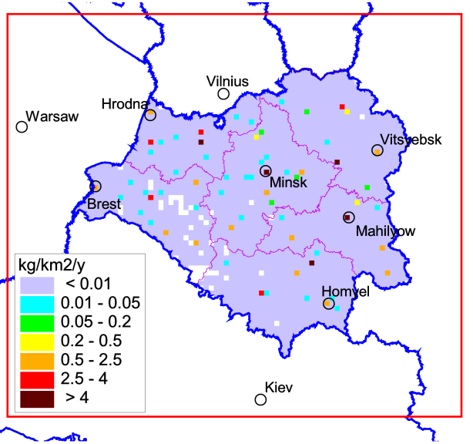
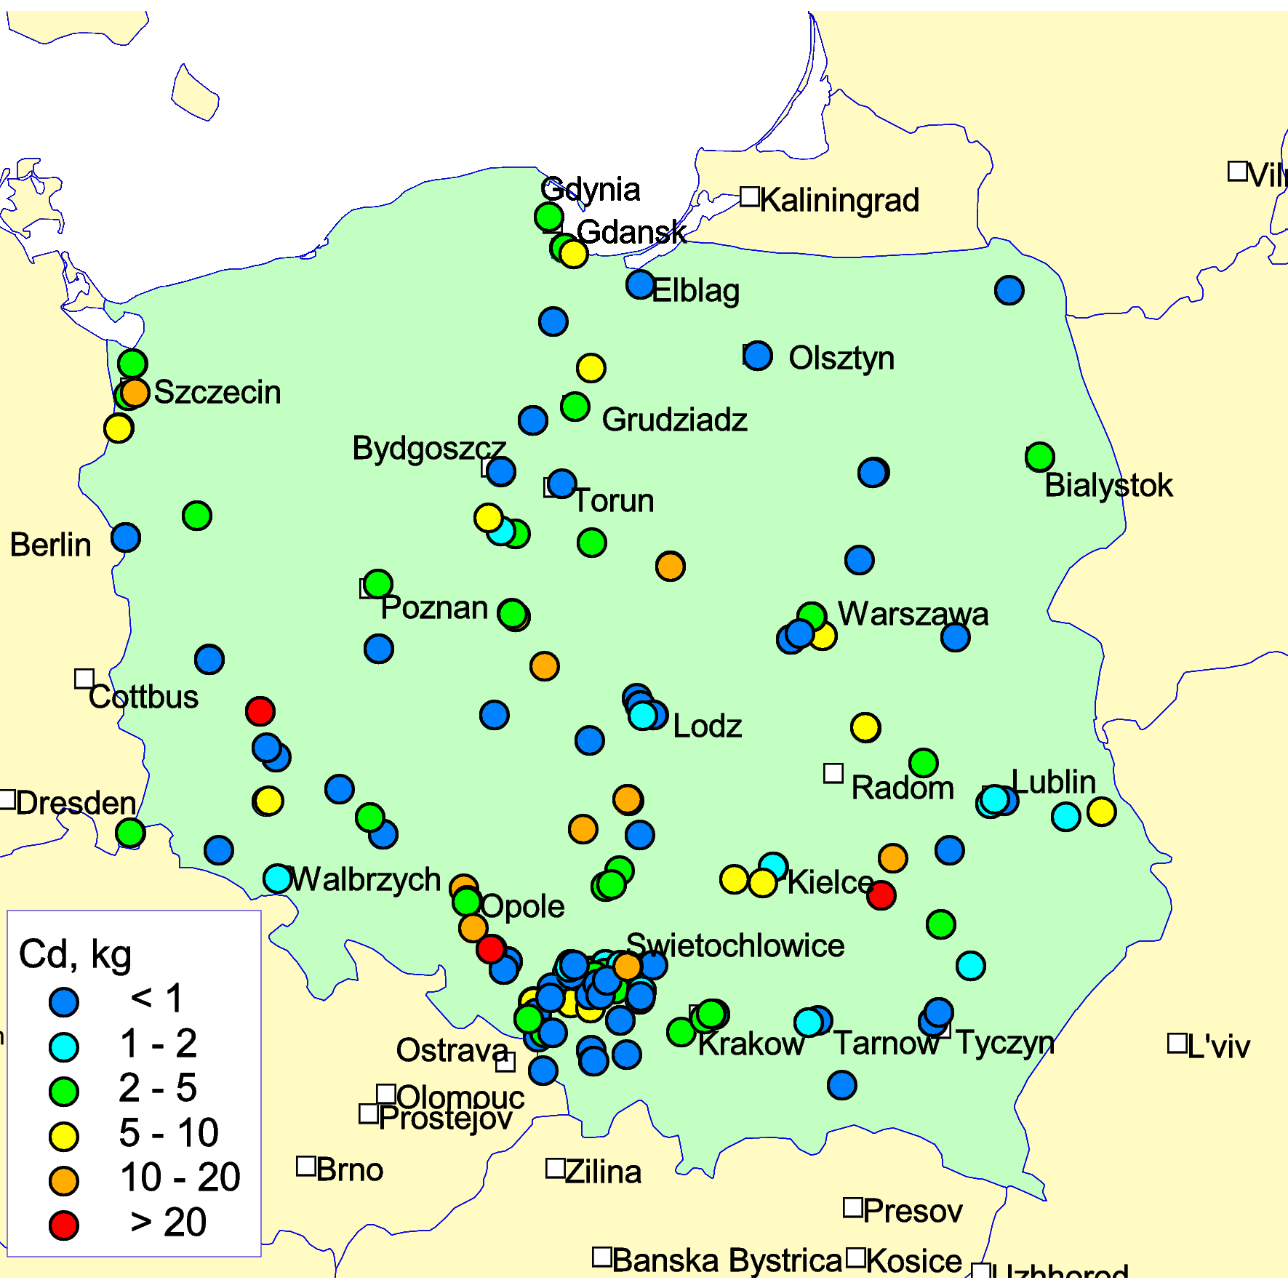
Case studies of HM pollution on national scale:
assessment of contamination with fine spatial resolution
Main outcomes and benefits:
Improvement of agreement between modelled and observed pollution levels
Better reproduction of small-scale effects (e.g., orographic precipitation)
Improvement of parameterization of wind re-suspension
Analysis of pollution using more detailed national emission and monitoring data
Belarus
UK
Poland
Recent and ongoing activities (2015-2017):
Analysis of Pb pollution levels in Belarus
Multi-model study of Pb pollution for the UK
Analysis of Cd pollution in Poland

Slide 4
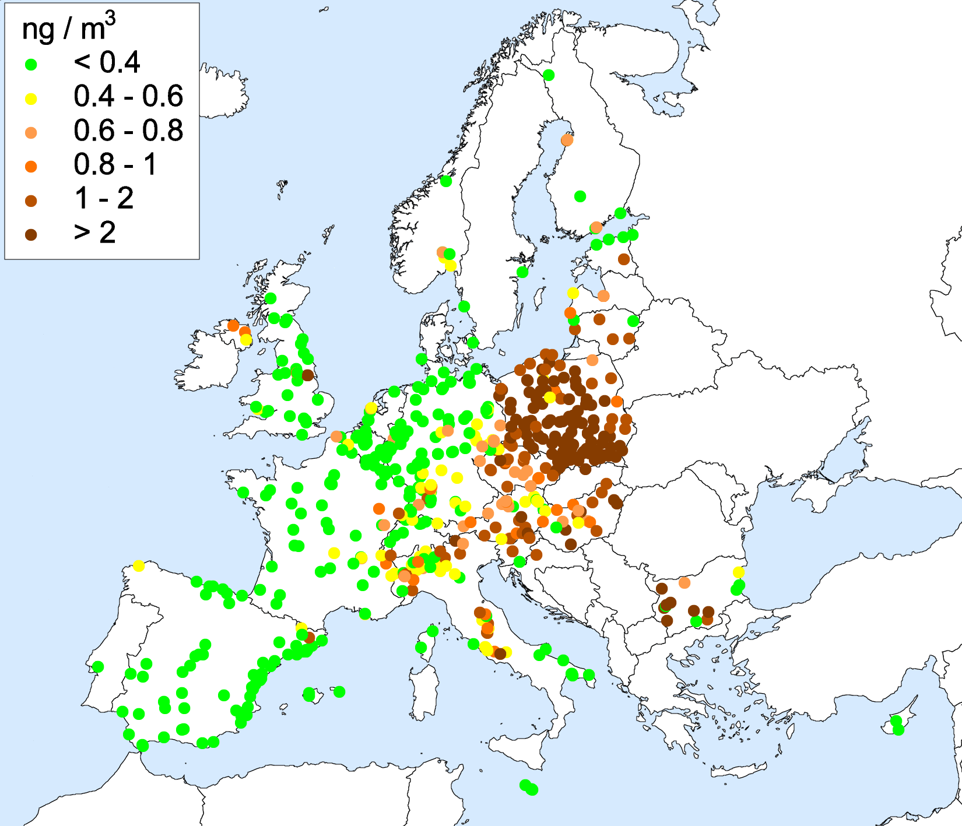
Evaluation of B(a)P pollution in urban areas
Significant part of urban population in Europe live in areas with exceedances of limit values for B(a)P air concentrations
About half of urban/suburban monitoring stations in Europe measuring B(a)P in air indicate concentrations above the EU target value 1 ng/m³ (EEA, 2015)
Objective of this activity is to estimate B(a)P pollution levels in urban areas of EMEP countries and provide information for exposure studies
Czech Republic
EU target value
Observed B(a)P air concentrations in 2013 (EEA Airbase)

Slide 5
Long-term trends of HMs and POPs
Contribution to CLRTAP, WGE and TFMM Assessments-2016
Trend evaluation for the whole EMEP domain and particular countries
based on model calculations
Non-linear character of the pollution trends was investigated (methodology of
analysis was elaborated and applied)
100
Pb
Cd
Hg
B[a]P
80
60
EMEP
40
Total redcution, %
EU28
20
0
EECCA
-20
-40
Reduction of HMs and B[a]P in the EMEP region, EU28 and EECCA countries
Trends in B[a]P air concentrations in the EMEP countries

Slide 6
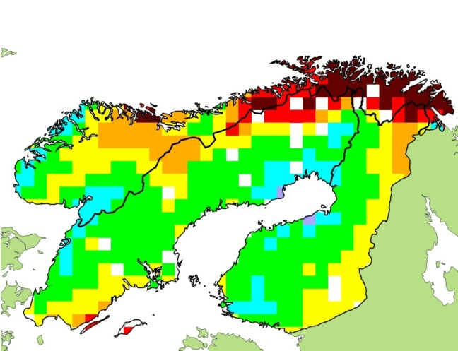
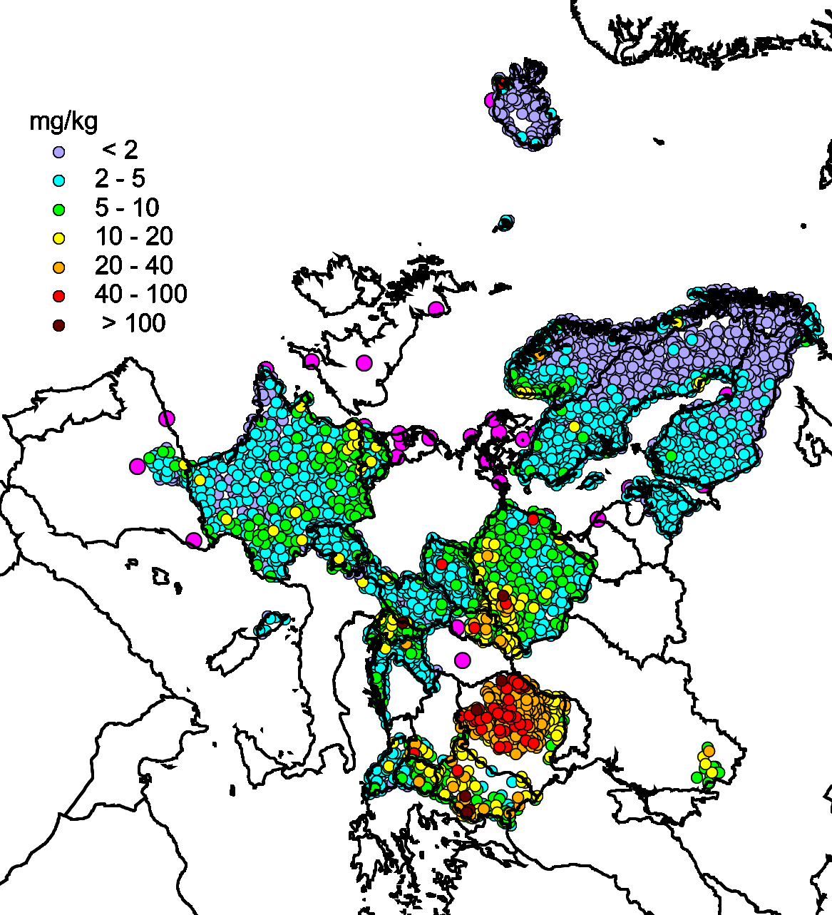
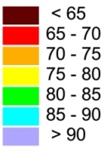
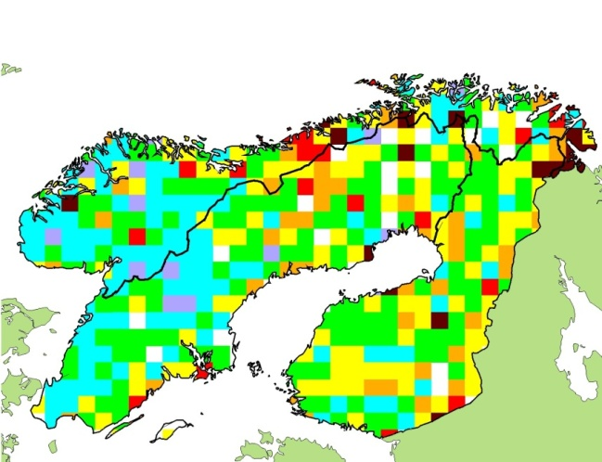
Long-term trends of HMs
Application of moss concentrations data with fine resolution to analysis of pollution levels in co-operation with WGE
Reduction (%) of Pb modelled deposition
Lead in mosses
Reduction (%) of Pb observed conc. in mosses
Moss measurements (2010)
29th TF meeting of the ICP-Vegetation, Dubna, Russia, March 2016

Slide 7
Further development of HM and POP modelling approach
Global EMEP Multi-media Modelling System (GLEMOS)
GLEMOS – EMEP model for evaluation of HMs and POPs at global/regional/national scales
GLEMOS general scheme
Main activities:
Transition of modelling system to new EMEP grid
Improvement of model performance of mercury pollution assessment
Further development and testing of multi-media approach for POPs
Update of open-code version of GLEMOS model
Anthropogenic
emissions
Meteorology,
ocean data
Geophysics
Atmosphere
Concentration
in media
Ocean
Land
Atmospheric
deposition
Human & environment
exposure (CCE)

Slide 8
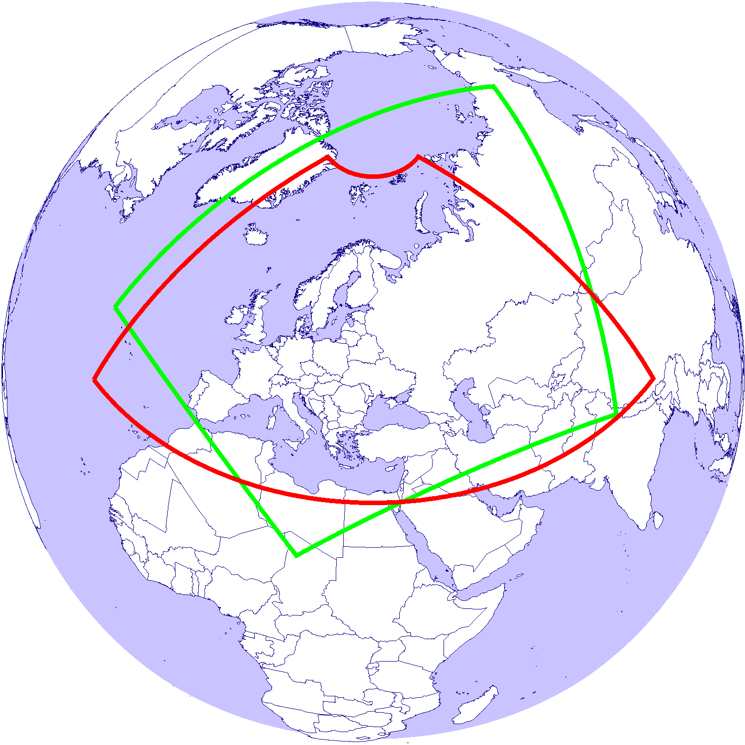
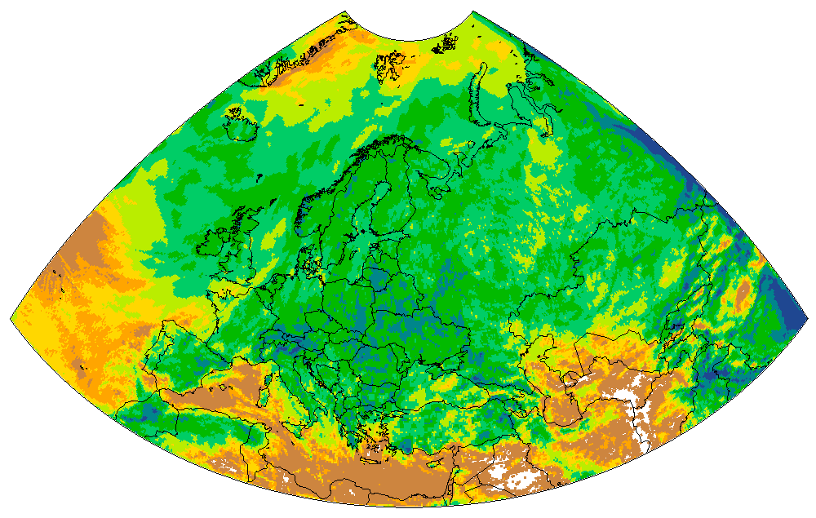
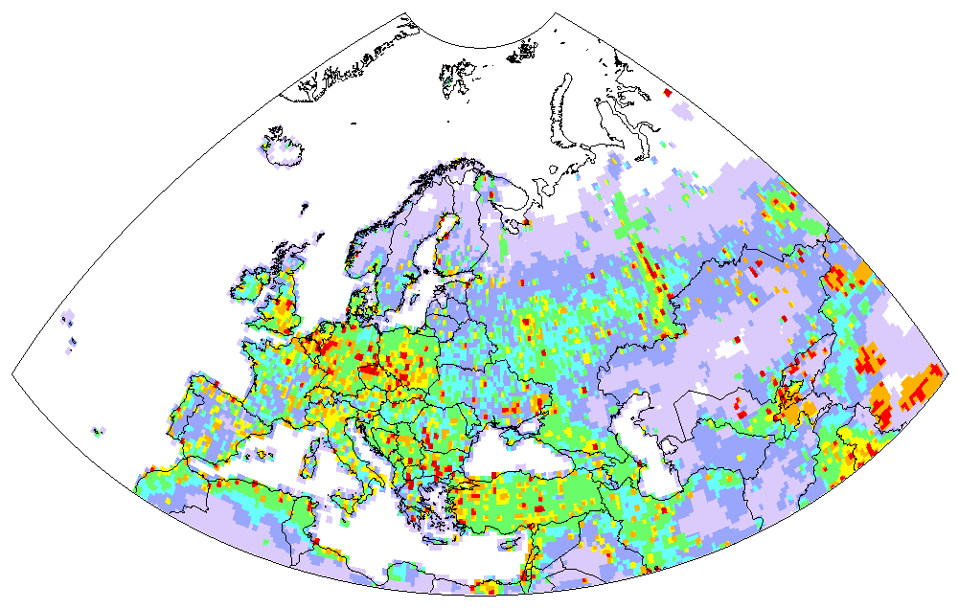
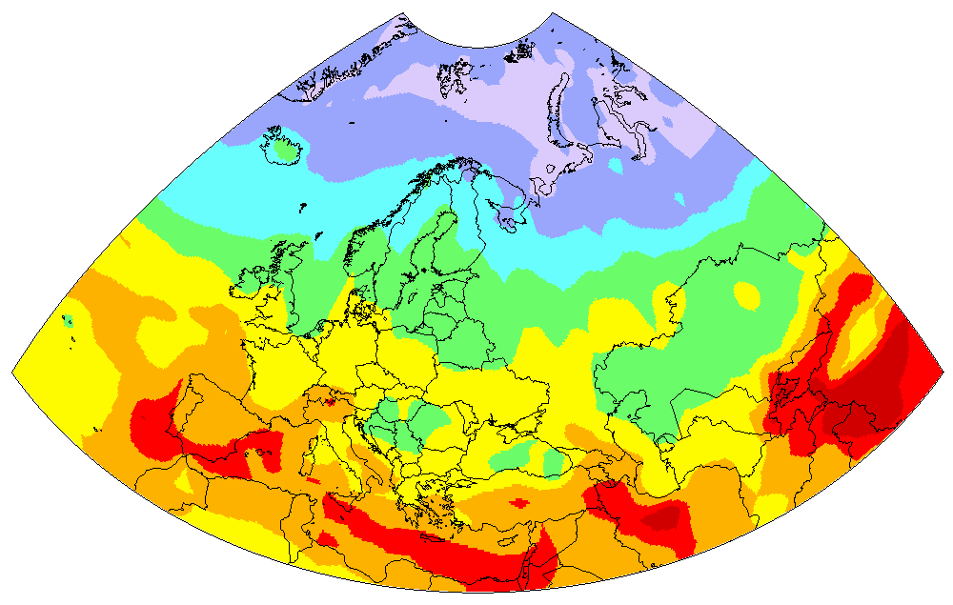
Transition to the new EMEP grid
Current and new EMEP domains
Current activities on implementation of the new grid:
Current EMEP domain
Data preparation on chemical reactants in the atmosphere
Generation of meteorological data (time series)
Preparation of emissions data based on expert estimates (official data is not available)
New EMEP domain
Pilot simulations and evaluation against measurements

Slide 9
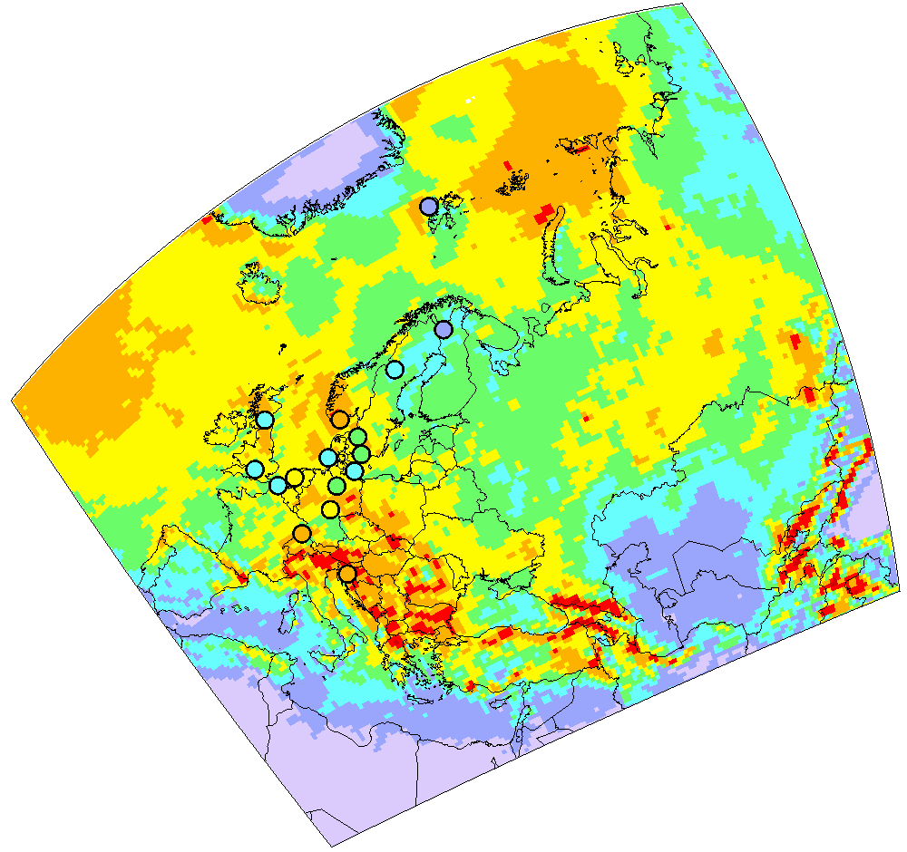
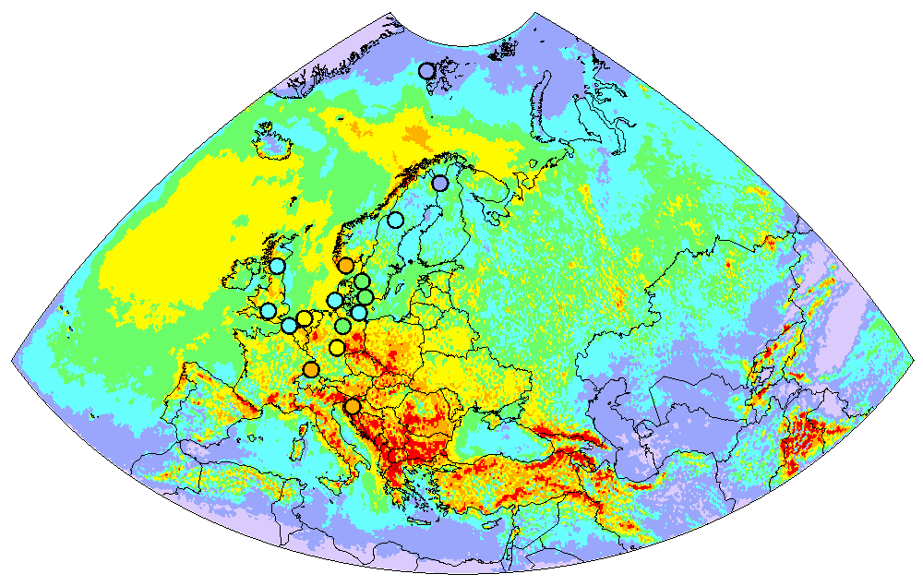
Transition to the new EMEP grid
Pilot simulations of Hg pollution over the new EMEP grid (2014)
Hg wet deposition (old EMEP grid)
Hg wet deposition (new EMEP grid)

Slide 10
Transition to the new EMEP grid
Evaluation of modelling results vs. EMEP measurements
Hg⁰ air concentration
Hg wet deposition
 | Old grid | New grid
Correlation | 0.63 | 0.60
Regression | 1.06 | 1.11
 | Old grid | New grid
Correlation | 0.72 | 0.92
Regression | 1.40 | 1.35

Slide 11
Development of emission preparation strategy:
co-operation with CEIP and TFEIP
Emission data required for model assessment of pollution:
Information on HM (Pb, Cd, Hg) and POP (PAHs, HCB, PCBs, PCDD/Fs) emissions | Official emission data (CEIP) | Emission data required for modeling (MSC-E)
Time-series of national total emissions (annually) | X
Gridded sectoral emissions (once in five years) | X
Emissions of Large Point Sources (once in five years) | X
Gridded total emissions for the latest reported year generated by CEIP (except PCBs) (annually) | X
Time-series of gridded annual emissions 1990-2012 |  | X
Vertical distribution of emissions |  | X
Speciation of Hg forms (Hg˚, Hg(II)_{gas}, Hg(II)_{part}) |  | X
Congener composition for POPs (PCDD/Fs – 17 congeners, PCBs) |  | X
Temporal variation of emissions |  | X
Historical emissions of PCBs, HCB, PCDD/Fs up to 1990 |  | X
Emissions to other environmental compartments (PCDD/Fs, HCB) |  | X
Emissions for non-EMEP countries within the EMEP domain (North Africa and Middle East) |  | X
Natural emissions |  | X
Re-suspension, re-emissions |  | X
Global emission inventories (PCDD/Fs, HCB, PCBs, Hg) |  | X
(MSC-E contribution to the joint CEIP/MSC-E technical report)

Slide 12
Priorities for emission data preparation for modelling
Emission parameter | Pb and Cd | Hg | PAHs | PCDD/Fs and PCBs | HCB
Quality of gridded anthropogenic emissions | 1 | 2 | 1 | 1 | 2
Chemical composition | - | 1 | - | 2 | -
Temporal variation | 2 | 6 | 2 | 6 | 5
Vertical distribution | 3 | 7 | 3 | 7 | 6
Global emissions inventory | 4 | 3 | 4 | 3 | 3
Historical emissions | 5 | 4 | 5 | 4 | 1
Emissions to other media | 6 | 5 | 6 | 5 | 4
- First priority - Second priority - Third priority
Key emission parameters affecting quality of model estimates

Slide 13
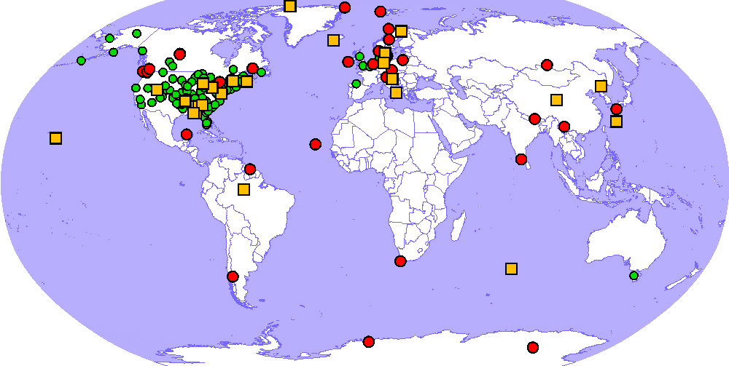
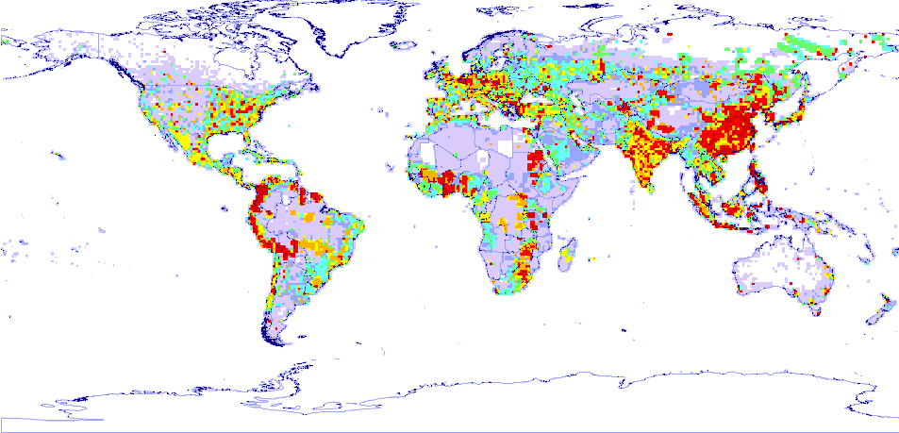
Assessment of mercury pollution in the EMEP region:
co-operation with international bodies
Global data on mercury emissions and pollution:
Hg measurement data from various monitoring networks
(GMOS, NADP/MDN, AMNet, NAtChem)
Hg emissions data (AMAP/UNEP global Hg inventory for 2010,
EGDARv4 global Hg inventory for 1970-2008)
Location of monitoring sites
Hg anthropogenic emission in 2010 (UNEP)
Hg⁰ concentration in air
Hg oxidized species in air
Wet deposition
Notes:
13
13

Slide 14
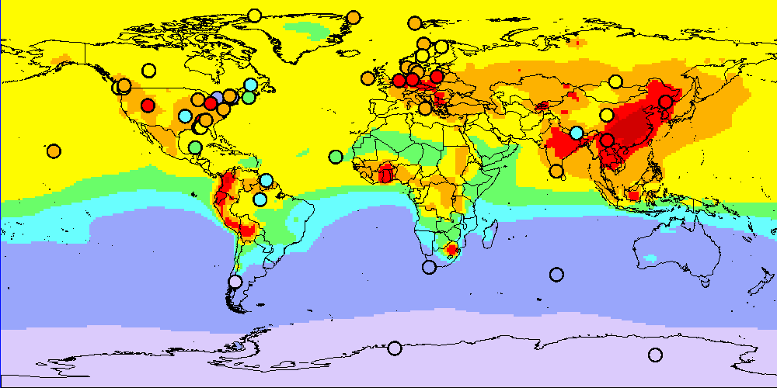
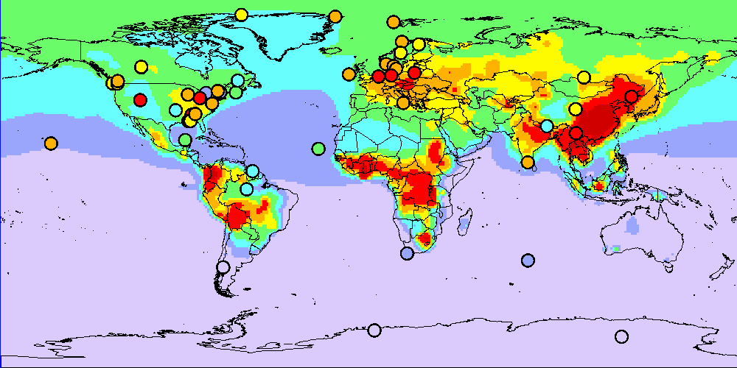
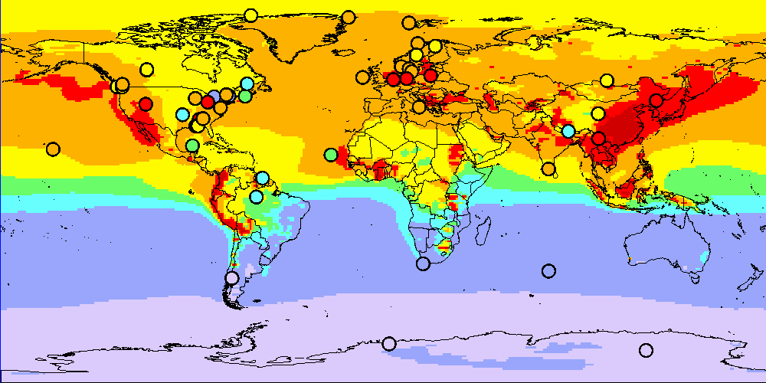
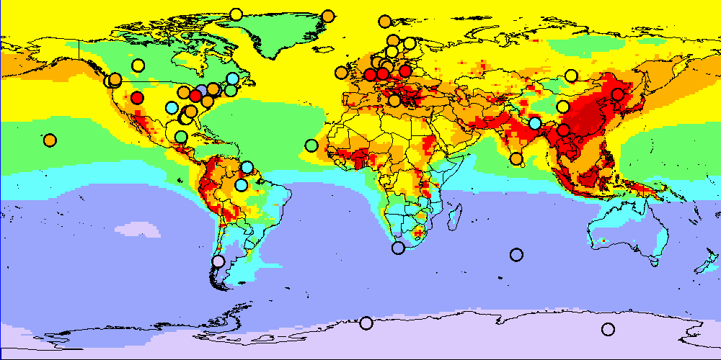





Multi-model assessment of global mercury pollution and processes
Participating models:
Model | National experts
GLEMOS | EMEP/MSC-E
ECHMERIT | CNR-IIA (Italy)
CMAQ-Hg | HZG (Germany)
WRF-Chem | CNR-IIA (Italy)
GEOS-Chem | MIT (USA)
GEM-MACH-Hg | Environment Canada
p-TOMCAT | Cambridge (UK)
GEOS-Chem
ECHMERIT
GEM-MACH-Hg
GLEMOS
TF HTAP Workshop, Potsdam, Germany, February 2016
Environment Canada
Notes:
14

Slide 15
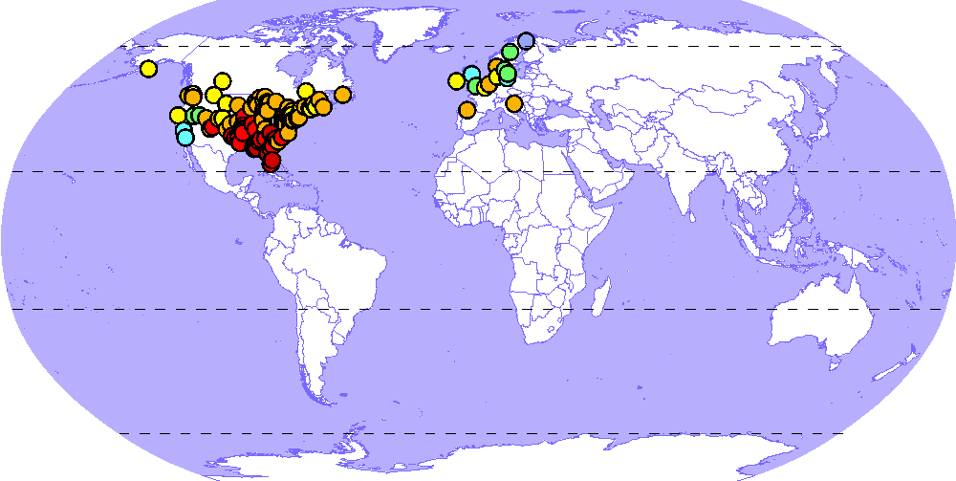
Study of Hg atmospheric chemistry
Seasonal variation of Hg wet deposition
/day
80
Sites measuring Hg wet deposition
2
Hg⁰ + Br
60
40
Wet deposition, ng/m
20
0
Jan
Mar
Apr
May
Jun
Jul
Aug
Oct
Nov
Feb
Sep
Dec
/day
80
Hg⁰ + O₃
80
2
60
/day
99 sites
2
40
60
Wet deposition, ng/m
40
20
Wet deposition, ng/m
0
20
Jan
Feb
Mar
Apr
May
Jun
Jul
Aug
Sep
Oct
Nov
Dec
/day
80
Hg⁰ + OH
0
2
60
Jan
Feb
Mar
Apr
May
Jun
Jul
Aug
Sep
Oct
Nov
Dec
40
Wet deposition, ng/m
Measurements
GLEMOS
GEOS-Chem
20
GEM-MACH-Hg
ECHMERIT
0
Jan
Mar
Apr
May
Jun
Jul
Oct
Nov
Feb
Aug
Sep
Dec

Slide 16
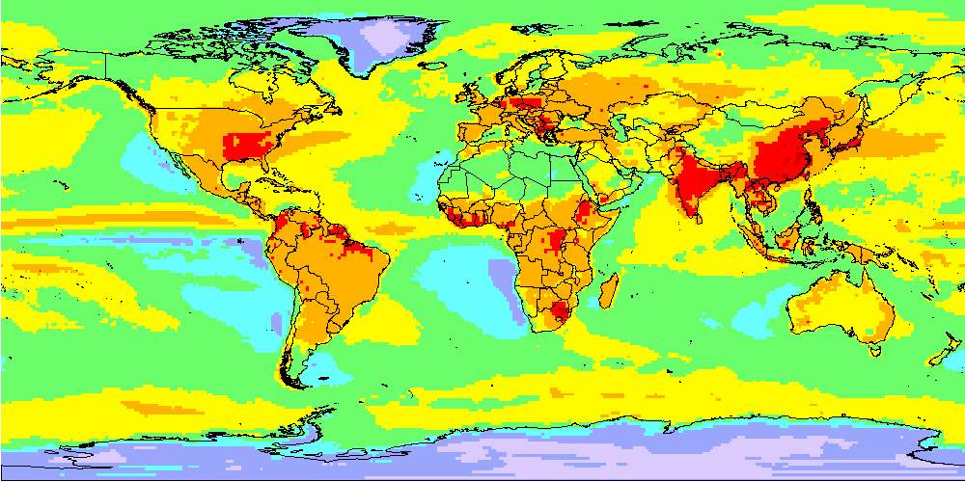
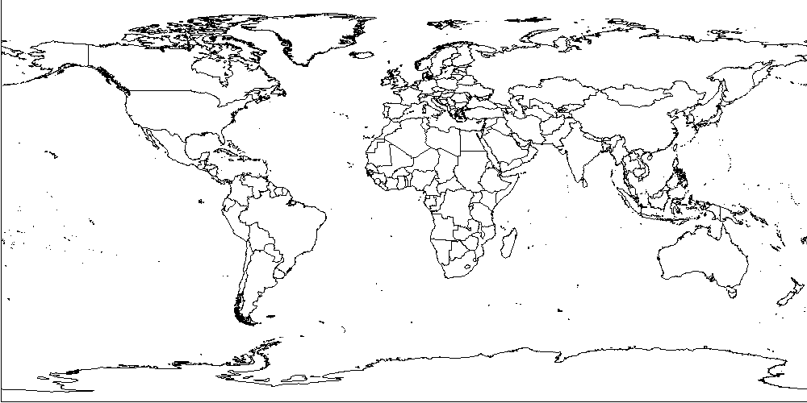
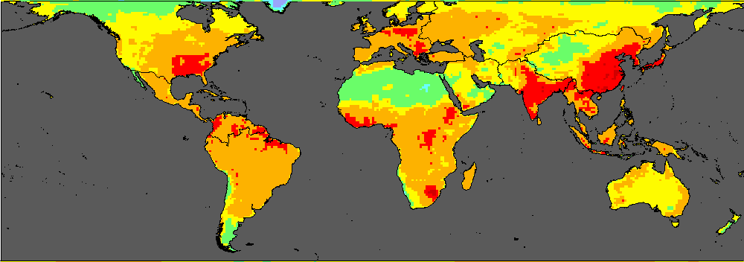
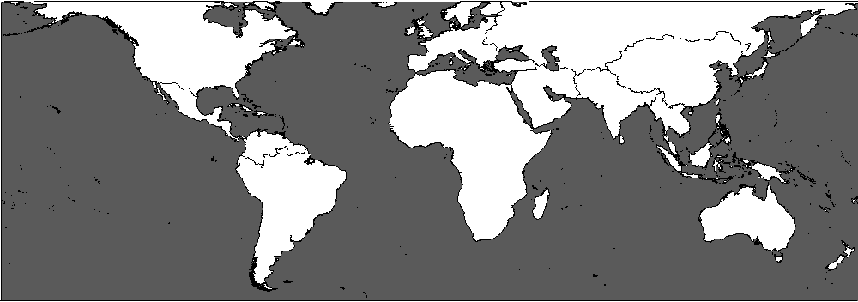
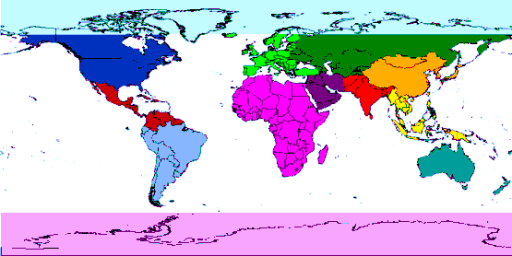
Assessment of mercury pollution on global scale
Source apportionment of Hg anthropogenic deposition
EMEP region
Simulated Hg deposition flux (2010)
12
2
/y
10
Source/receptor regions
8
Arctic
Middle East
6
Europe
Africa
Average Hg deposition, g/km
CIS countries
South Asia
4
North America
East Asia
2
Central America
Southeast Asia
0
South America
Australia and NZ
Antarctica
Notes:
16

Slide 17
Contribution to UNEP Global Mercury Assessment
Participation in the Global Mercury Assessment 2013 (GMA 2013) to support negotiations of the Minamata Convention on Mercury.
Coordination of work on the update of GMA 2013 with new modelling results (2015)
Leading preparation of the modelling part of Global Mercury Assessment 2018
Project Coordination Group of GMA 2018 (Geneva, April 2016)

Slide 18
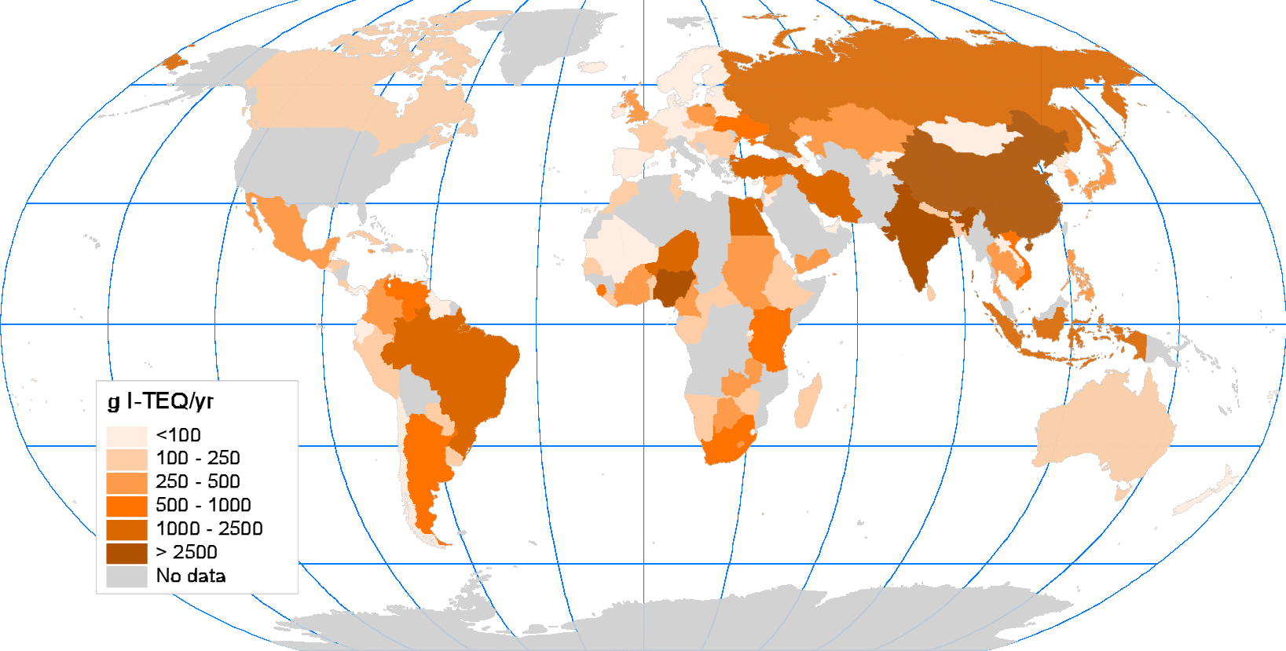
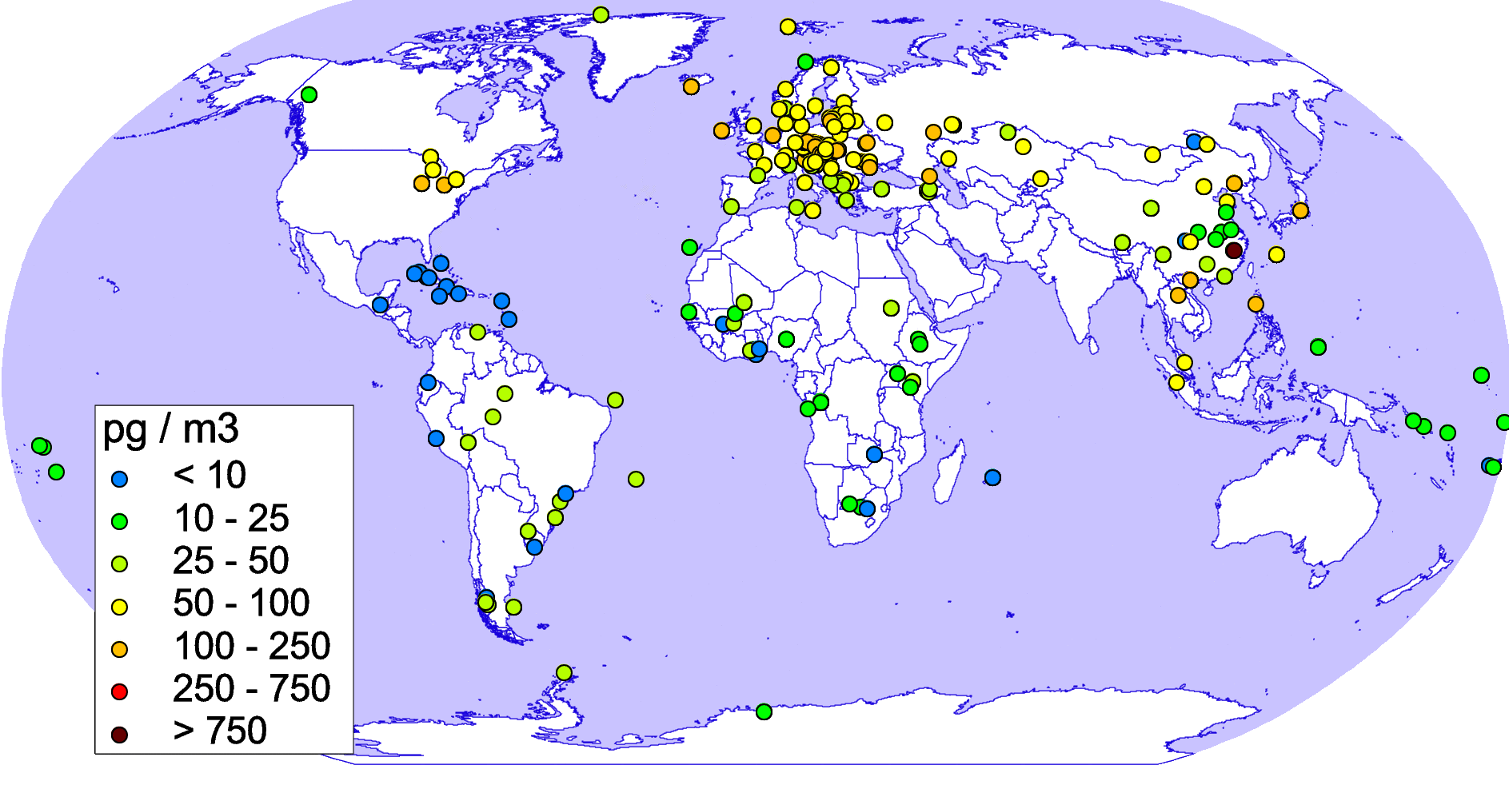
Assessment of POP pollution:
co-operation with UNEP Stockholm Convention (SC)
Global data on emissions and measured pollution levels of POPs in air and media
PCDD/F emissions of more than 140 countries (based on UNEP Emission Toolkit)
Emission data include PCDD/F releases to air, land, and water
Measurements of PCBs, PCDD/Fs, HCB air concentrations over the globe
(SC GMP Data Warehouse)
Annual PCDD/F emissions to air (g I-TEQ/yr)
Measured HCB air concentrations (pg/m³)

Slide 19
Assessment of POP pollution and processes
Research activities related to regional and global scales:
Analysis of congener composition of emission and concentrations in media (PCDD/Fs, PCBs)
Refinement of parameterization of atmospheric transformation/removal processes and exchange with media
Further development of source-receptor methodology accounting for multi-media transport of POPs
Assessment of intercontinental transport to/from EMEP region
Multi-model study of global POP transport applying UNEP SC GMP measurement data
GLEMOS (EMEP/MSC-E)
BETR-Research (Switzerland/Sweden)
Measured and modelled PCB153 in air for the period 2004-2013, pg/m³

Slide 20
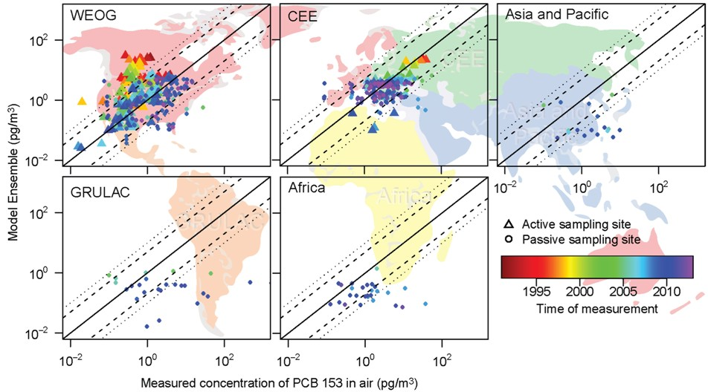
Multi-model assessment of POP pollution and processes
Study of global transport, phase partitioning, and media exchange
GLEMOS (MSC-E) and BETR (Sweden) models vs. measurements of UNEP SC GMP DWH
EMEP region
Contribution to the UNEP SC Second Global GMP report, 2016
Notes:
20

Slide 21
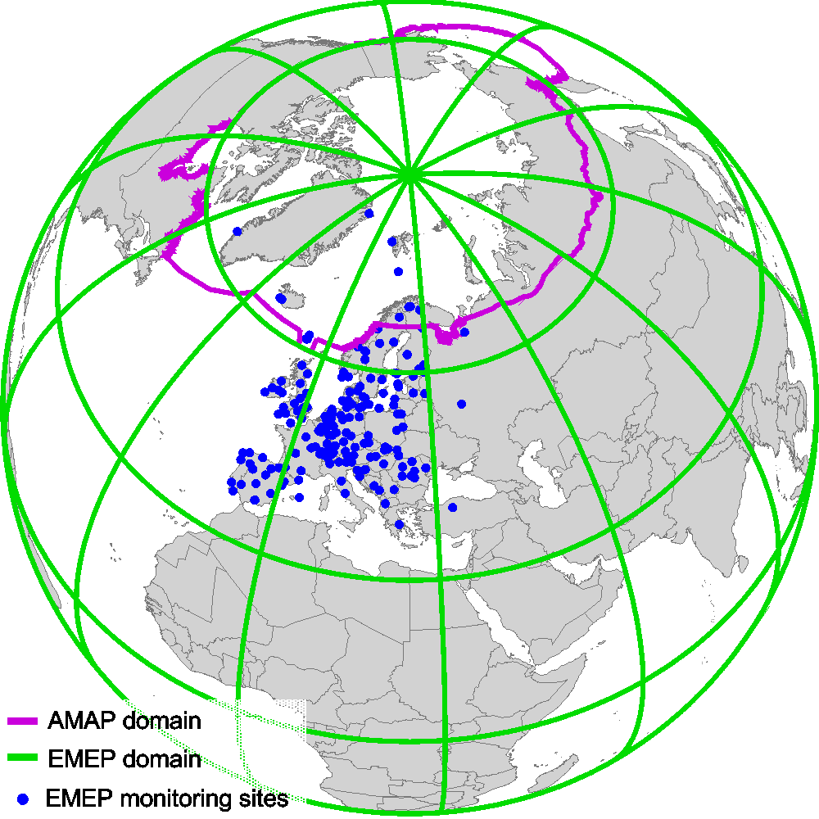
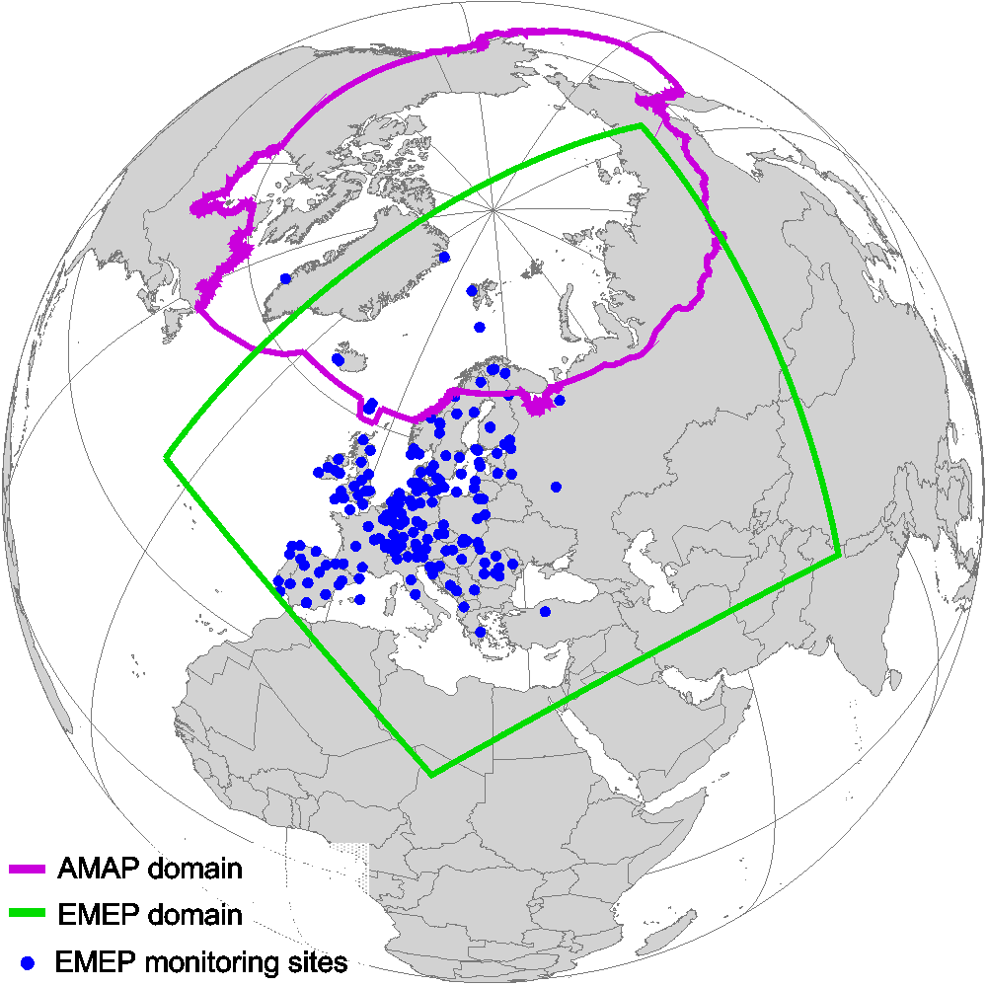
Cooperation with AMAP and dissemination of results
Joint AMAP/CLRTAP workshop, Potsdam, Germany, February 2016
AMAP and EMEP domains
MSC-E activities relevant to the Arctic
Regular pollution assessment over EMEP domain:
Substances – Pb, Cd, Hg, PAHs, HCB, PCBs, PCDD/Fs
Concentration and deposition maps
Source-receptor relationships
Long-term trends (1990-2013)
EMEP
Pollution assessment on a global scale:
Substances – Hg, HCB, PCBs, PCDD/Fs
Includes the whole AMAP region
Intercontinental transport

Slide 22
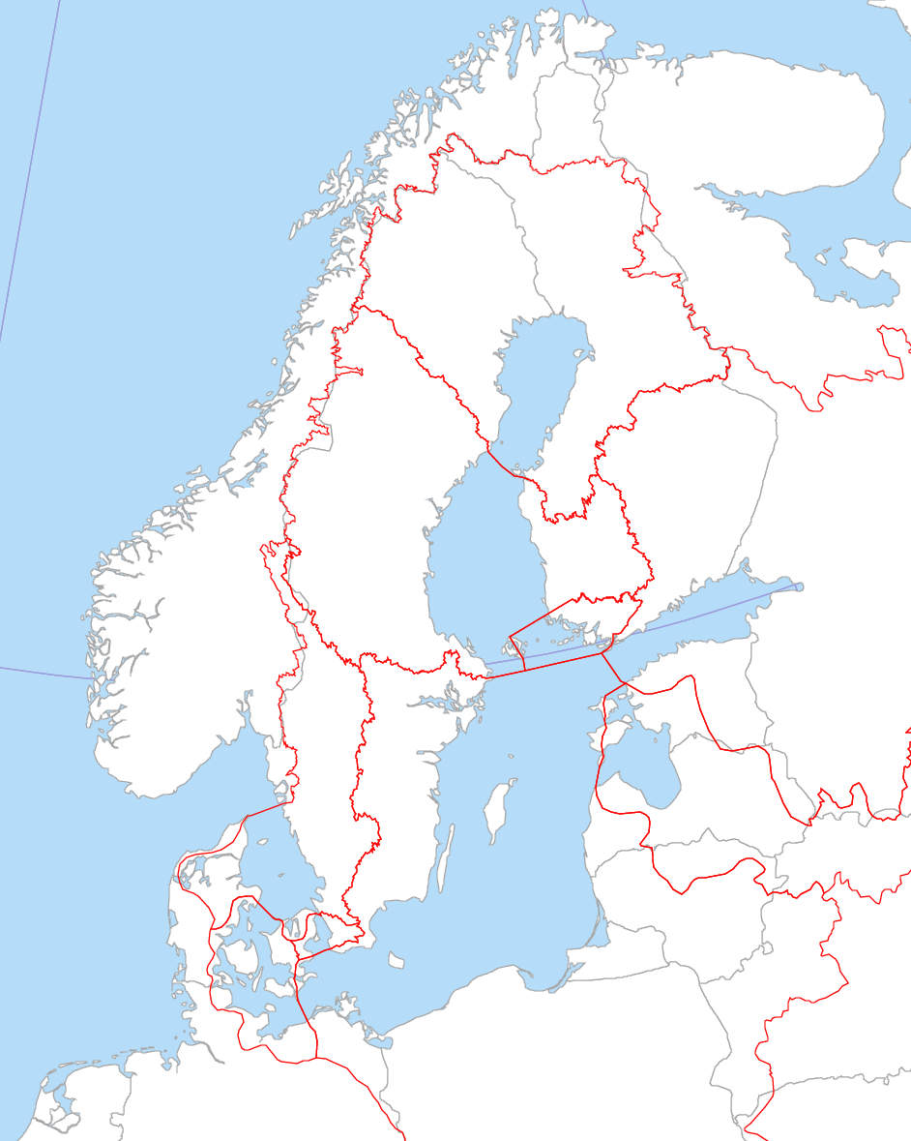

Cooperation with HELCOM and dissemination of results
Assessment of atmospheric input of HMs (Pb, Cd, Hg) and POPs
(PCDD/Fs, PAHs, PCBs) to the Baltic Sea
Deposition to the Baltic Sea
Source apportionment of Cd deposition
HELCOM expressed its interest for evaluation of Baltic Sea pollution by new substances (PBDE, HBCDD, PFOS) (PRESSURE group meeting, 2015)

Slide 23
Work-plan elements for 2017
Work on transition of modelling system to the new EMEP grid
Further development of multi-media modelling approach for mercury
Model evaluation of POP (B[a]P) contamination of highly populated regions (urban areas)
Country specific activities on HM pollution assessment with fine spatial resolution (Case studies: Poland, UK)
Contribution to the development of emission strategy
Refinement of model parameterization of phase partitioning and inter-media exchange of POPs
Co-operation and exchange of information with different international organizations (AMAP, UNEP Minamata and Stockholm Conventions, HELCOM)

Slide 24
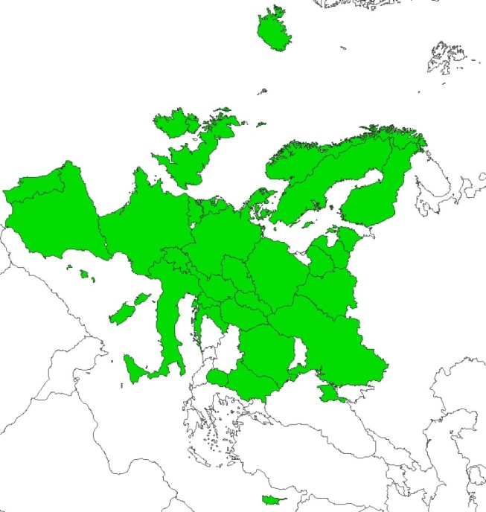
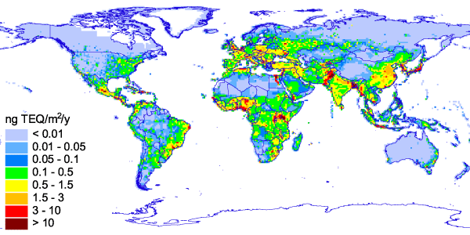
Emission characteristics affecting assessment of pollution
Temporal variations of B[a]P emissions at a particular location in Central Europe
Gridded emission data
areas covered
areas not covered
Spatial distribution of global annual PCDD/F emissions to the atmosphere

Slide 25
Multi-model study of Hg atmospheric chemistry
Seasonal variation of Hg wet deposition
Sites measuring Hg wet deposition
/day
80
99 sites
/day
50
14 sites
2
60
2
40
30
40
Wet deposition, ng/m
Wet deposition, ng/m
20
20
10
0
0
Jan
Feb
Mar
Apr
May
Jun
Jul
Aug
Sep
Oct
Nov
Dec
Jan
Feb
Mar
Apr
May
Jun
Jul
Aug
Sep
Oct
Nov
Dec
Measurements
GLEMOS
GEOS-Chem
GEM-MACH-Hg
ECHMERIT

Slide 26
Multi-model study of Hg atmospheric chemistry
Seasonal variation of wet deposition (North America)
Hg⁰ + Br (Br dataset I)
Hg⁰ + Br (Br dataset II)
/day
80
/day
80
2
60
2
60
40
40
Wet deposition, ng/m
Wet deposition, ng/m
20
20
0
0
Jan
Feb
Mar
Apr
May
Jun
Jul
Aug
Sep
Oct
Nov
Dec
Jan
Feb
Mar
Apr
May
Jun
Jul
Aug
Sep
Oct
Nov
Dec
Hg⁰ + O₃
Hg⁰ + OH
/day
80
/day
80
2
60
2
60
40
40
Wet deposition, ng/m
Wet deposition, ng/m
20
20
0
0
Jan
Feb
Mar
Apr
May
Jun
Jul
Aug
Sep
Oct
Nov
Dec
Jan
Feb
Mar
Apr
May
Jun
Jul
Aug
Sep
Oct
Nov
Dec
Measurements
GLEMOS
GEOS-Chem
GEM-MACH-Hg
ECHMERIT

Slide 27
Transition to the new EMEP grid
Comparison of model simulations on new and old grids
Average Hg deposition in EMEP countries (2014)

