Slide 1





8th Joint Session of the EMEP Steering Body and the Working Group on Effects
12-16 September, 2022
POP pollution assessment on national, regional, and global scales with focus on PAHs
MSC-E: A. Gusev, N. Batrakova, M. Kleimenov, O. Rozovskaya, V. Shatalov, N. Vulykh, I. Ilyin
CCC: K. Breivik, P. B. Nizzetto, K. A. Pfaffuffer, W. Aas
CEIP: S. Poupa, R. Wankmueller, B. Ullrich
Eurodelta-Carb B(a)P: M.G. Vivanco, M.R. Theobald, J.L. Garrido, V. Gil, F. Couvidat,
A. Collette, M. Mircea, M. Adani, I. Delia, R. D. Kouznetsov, E. V. Kadancev

Slide 2
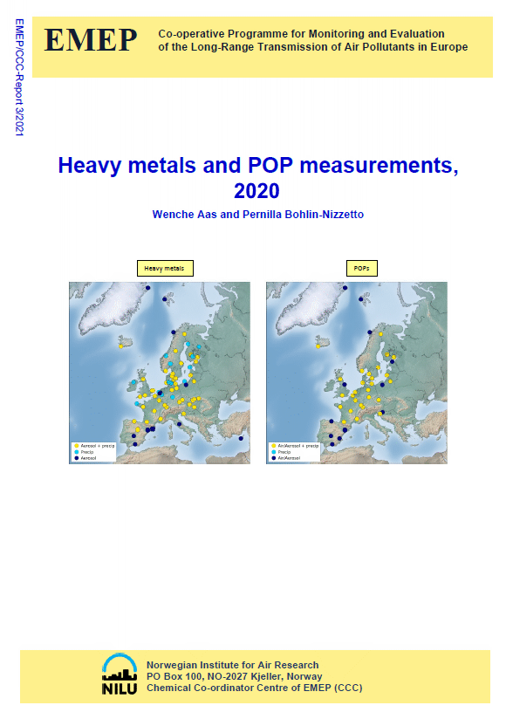
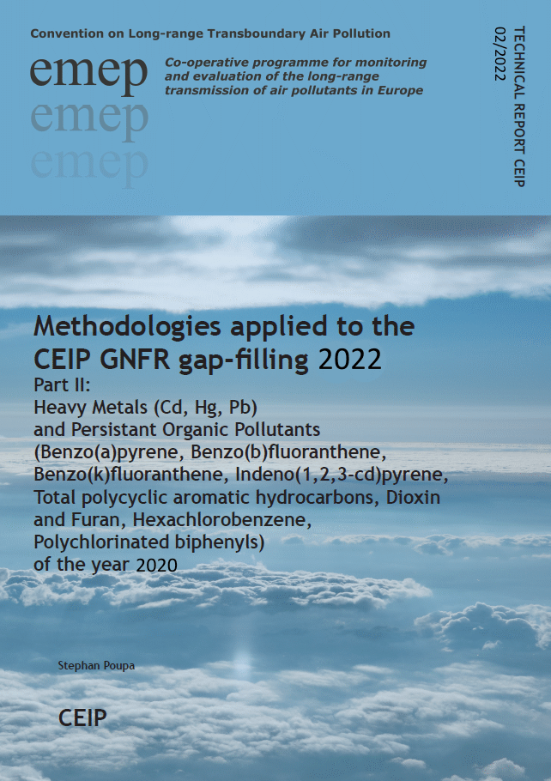
Operational and research activities on POPs in 2022
Main topics :
Operational activities
  Emissions of POPs in the EMEP region (CEIP)
  POP monitoring in the EMEP region (CCC)
  Model assessment of POPs (PAH, PCDD/F, PCB, HCB) pollution for 2020 (MSC-E)
Research activities and co-operation
  PAH pollution assessment:
  Eurodelta-Carb BaP (TFMM),
  Case study for Poland (TFMM),
  A pilot study of B(a)P pollution from wildfires
  Analysis of temporal changes of POP pollution (WGE)
  Assessment of global-scale POP pollution (TFHTAP)
  Contaminants of Emerging Concern (TFMM, HELCOM)
Plans on further activities
EMEP Status Reports 2022
www.msceast.org (MSC-E), www.ceip.at (CEIP), www.nilu.no/projects/ccc/ (CCC)

Slide 3
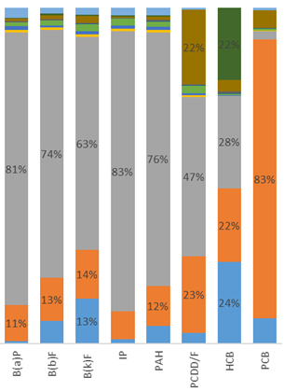
Emissions of POPs for modelling (CEIP)
Activities:
Analysis of reported POP emissions (gridded data, long-term changes) and gap-filling (CEIP)
Expert estimates of POP emissions and gridding for 2020 (CEIP)
Preparation of intra-annual changes and vertical distribution of emissions (MSC-E)
Compilation of global emission data (MSC-E)
Main sectors:
Residential combustion
Industry production
Public electricity/heat
Wastes
Agriculture
Challenges:
Reduction of uncertainties in reported spatial distribution of POP emissions
Refinement of POP emission inventories for eastern part of EMEP domain
Emission factors and inventories for wider list of POPs
GNFR sectors contribution to total POP emissions in EMEP domain (2020)

Slide 4
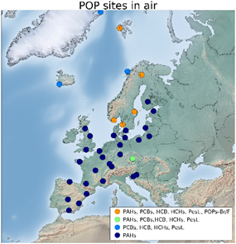
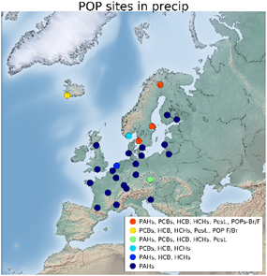
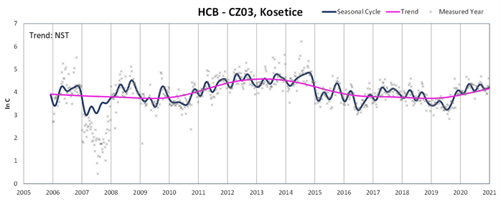
Monitoring of POPs (CCC)
Activities:
Collection and analysis of POP measurements of the EMEP network for 2020 (CCC)
Analysis of long-term and seasonal changes in observed HCB concentrations (CCC) [Platt et al., 2022, ACP]
Compilation of POP measurements from other databases/networks, e.g. EEA (MSC-E)
POP measurements in air (2020)
POP measurements in precipitation (2020)
Challenges/recommendations:
Laboratory intercomparisons for POP measurements
Difficulty of direct comparison between measurements obtained from various EMEP sites (different sampling strategies)
Reduction of uncertainties of POP air/precipitation measurements
Trends in observed HCB in air (2005-2021)

Slide 5
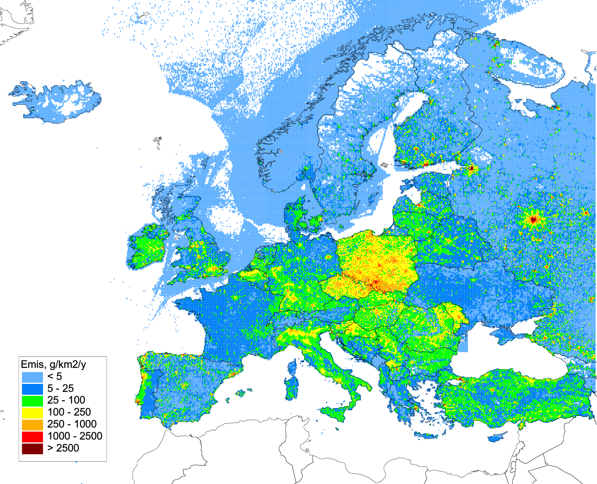
PAH assessment: multi-model study of B(a)P pollution
Contribution to Eurodelta-Carb model intercomparison project (TFMM)
Objectives:
Assessment of B(a)P pollution levels and exceedances of air quality guidelines
Analysis of model predictions and reasons of differences between the models
Evaluation of B(a)P/PM emissions from ‘residential combustion’ sector
Analysis of links of B(a)P and PM components (OC, EC)
Contribute to further development of B(a)P modelling approach
Participating models:
Annual B(a)P emissions within
Eurodelta-Carb modelling domain (2018)
Model | Institution | Uploaded to FTP server
CHIMERE | CIEMAT (Spain), INERIS (France) | B(a)P
GLEMOS | EMEP/MSC-E | B(a)P
MINNI | ENEA (Italy) | B(a)P, O₃, OC, EC, PM2.5, …
SILAM | FMI (Finland) | B(a)P, O₃, OC, EC, PM2.5, …

Slide 6
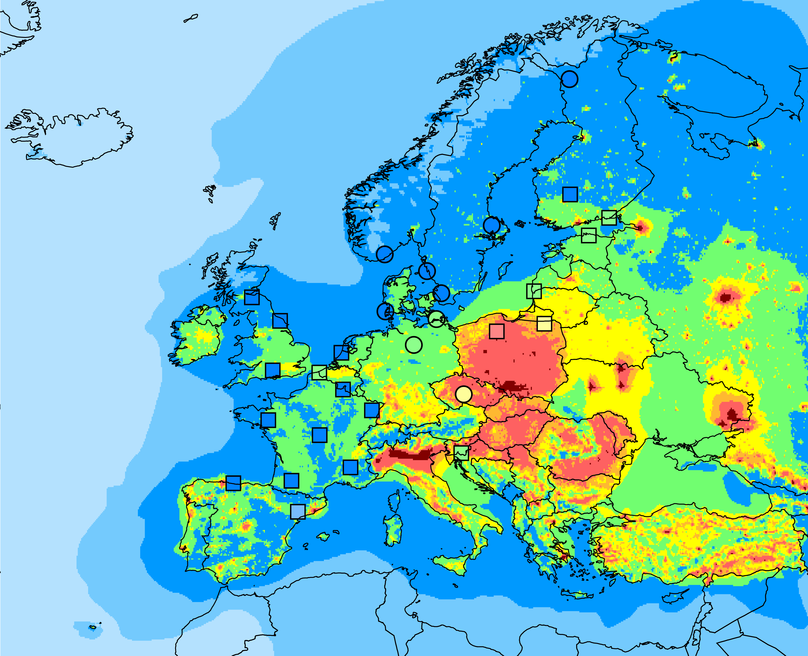
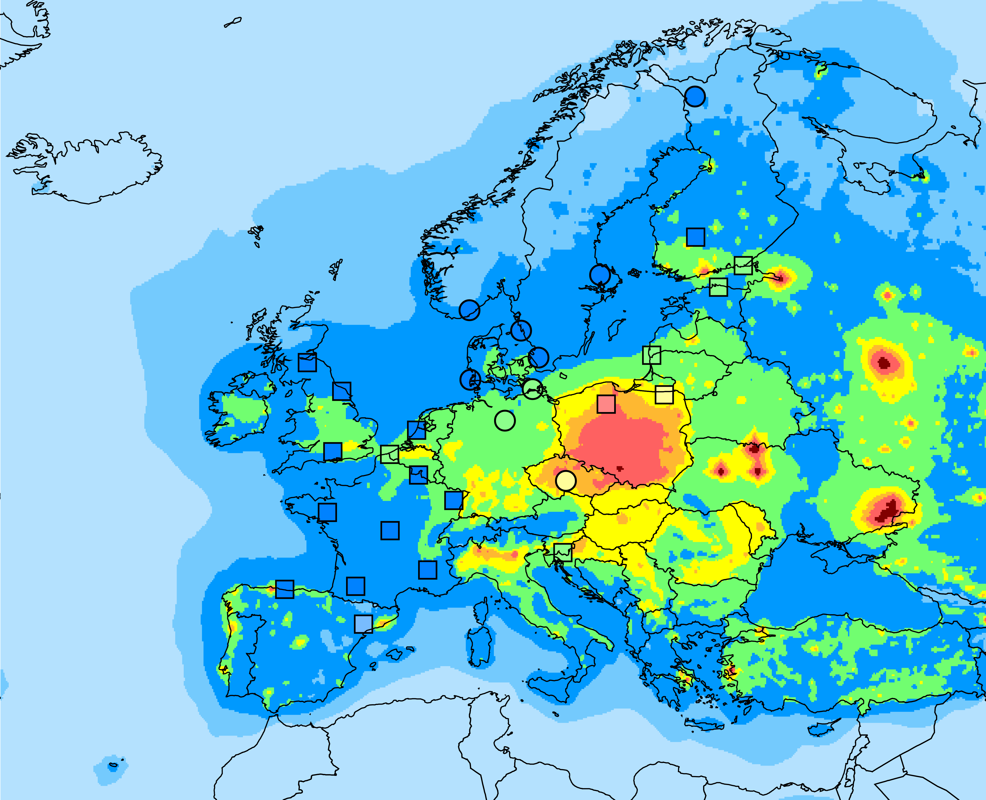
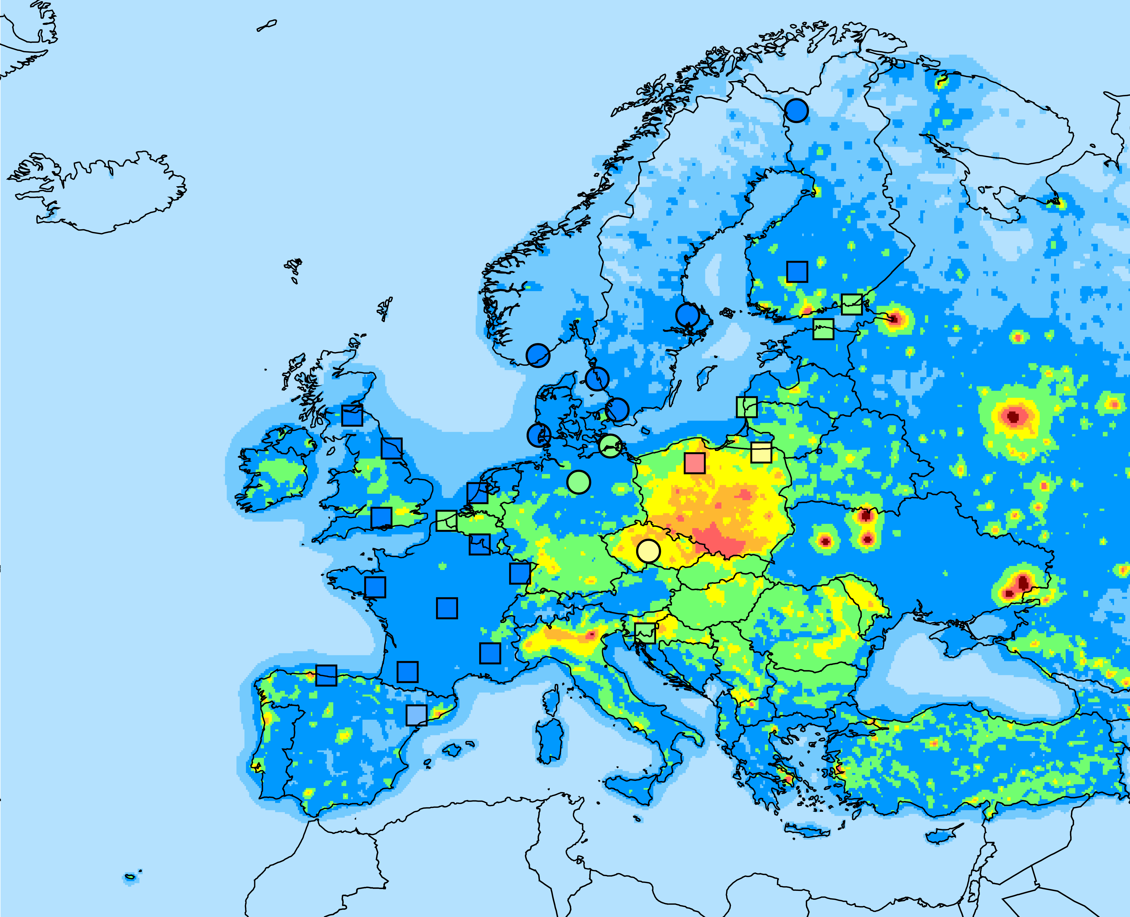
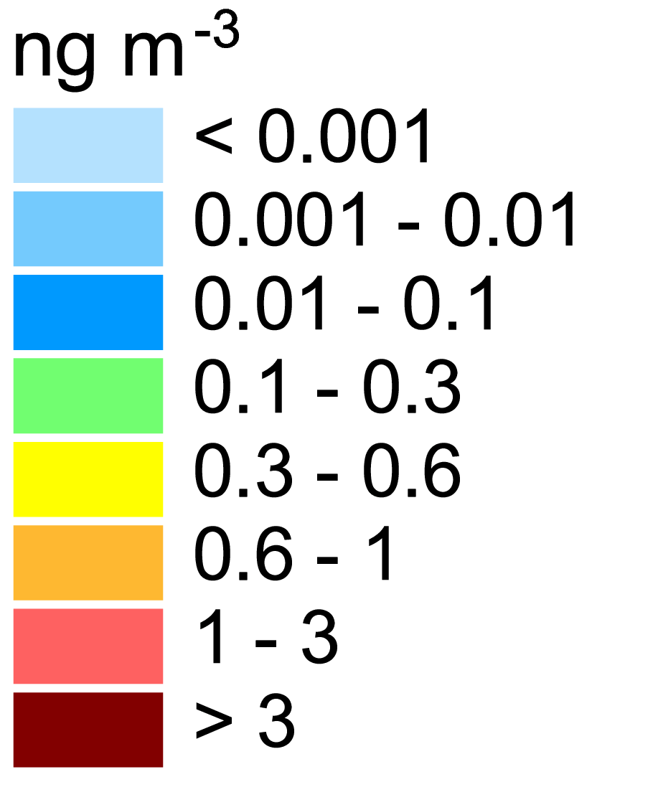
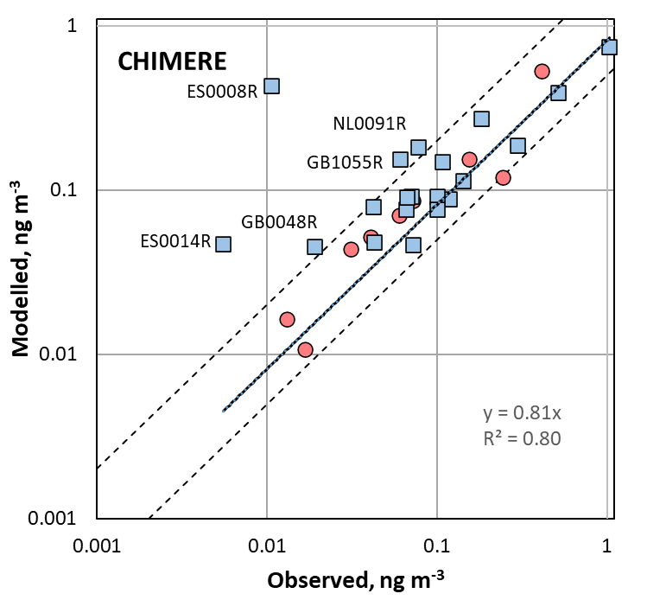
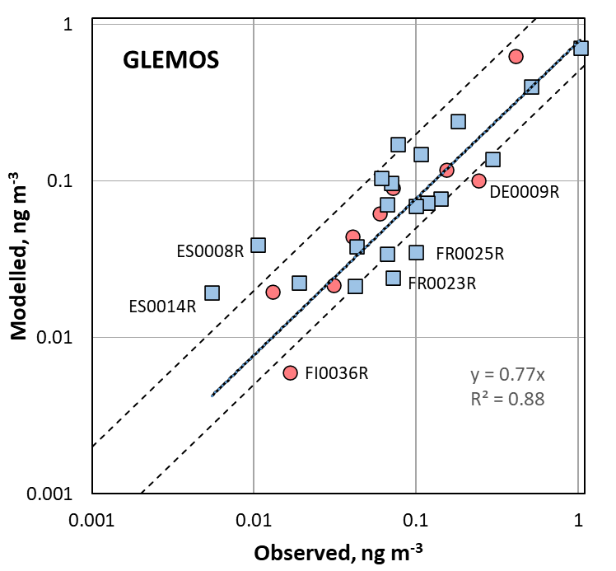
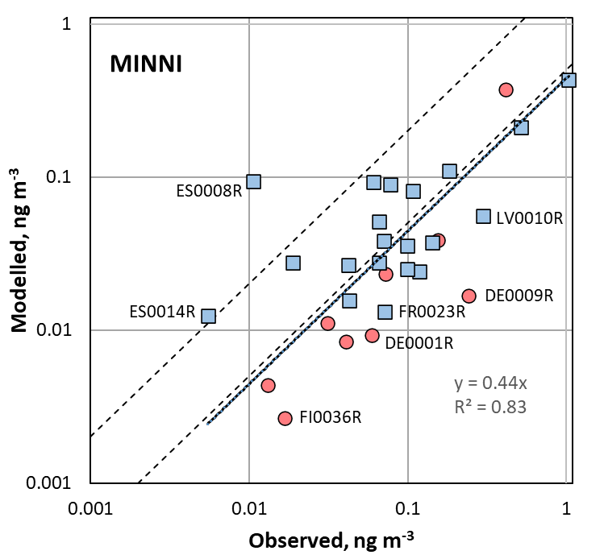
Modelled vs observed B(a)P concentrations (EMEP stations)
Annual mean modelled B(a)P concentrations (2018) vs data of 29 EMEP stations
CHIMERE
GLEMOS
MINNI
x2
x0.5
Gas+particle phase B(a)P
Particle phase B(a)P

Slide 7
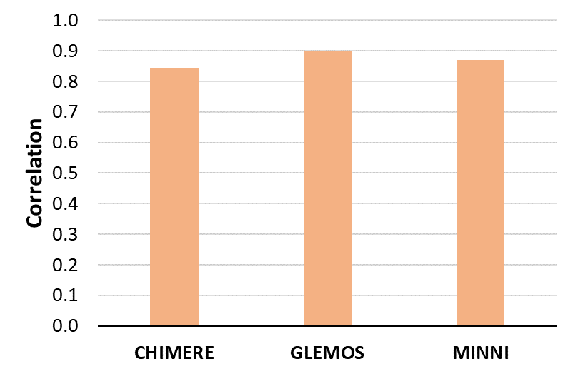
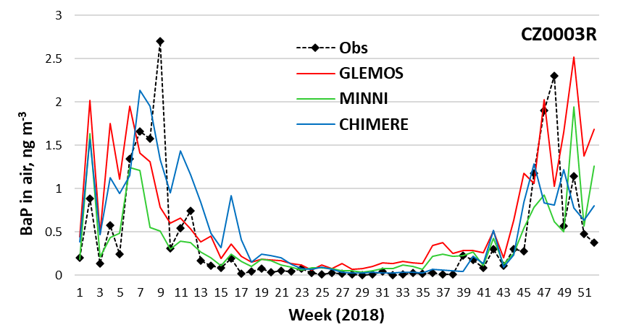
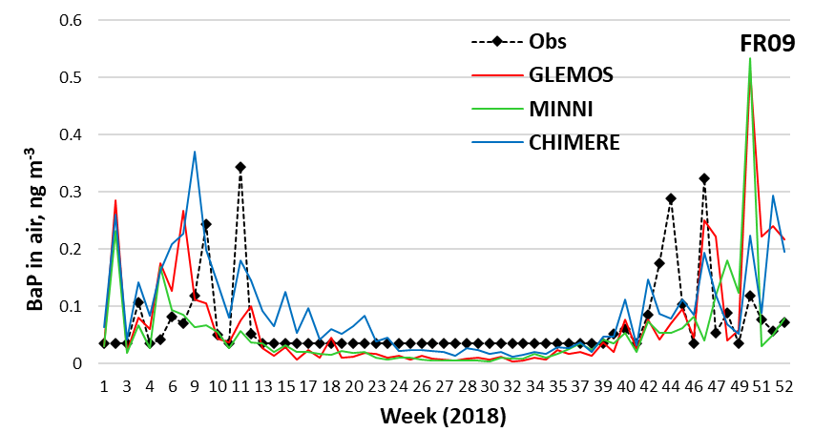
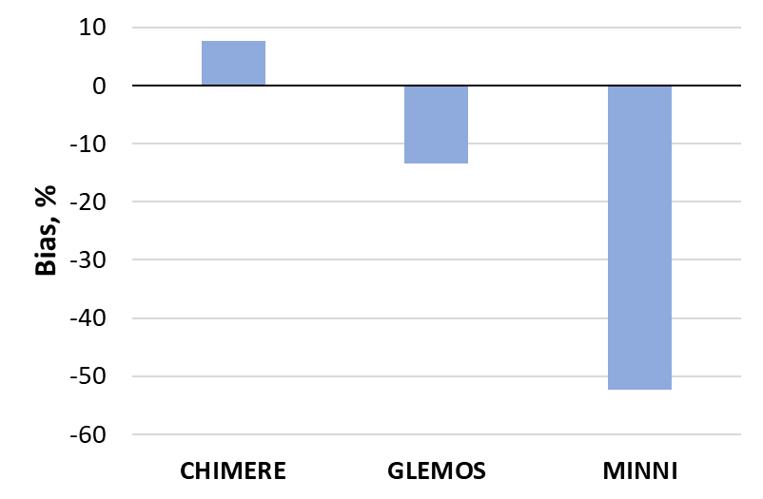
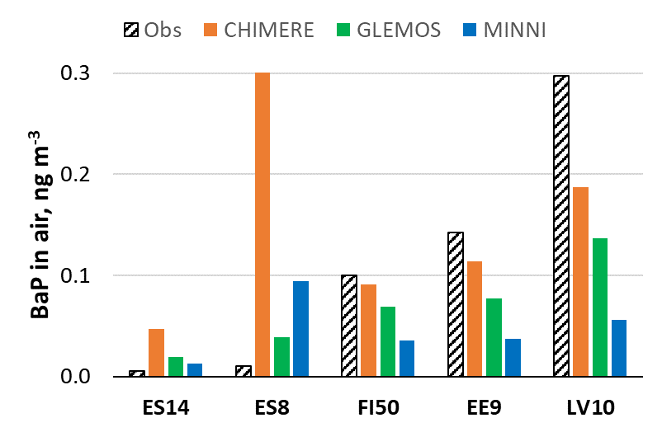
Eurodelta-Carb: current progress and further activities
Preliminary conclusions:
High spatial correlation of modelled and measured concentrations
Significant differences between model biases (different parameterizations of B(a)P degradation in particulate phase)
Models overpredict observed concentrations in Spain and underpredict in Finland, Latvia, Estonia (uncertainties in emissions)
High correlation with observed intra-annual B(a)P variations
Differences between models for particular months (different factors of emission temporalization)
GLEMOS
Further activities:
Detailed analysis of model-to-measurements and model-to-model differences and factors controlling them
Presentation of the progress at the HARMO21 conference, Sept 27-30 (Portugal)
Technical meeting to discuss progress of Eurodelta-Carb study (Nov 2022)
Presentation of results at the TFMM meeting in May 2023

Slide 8
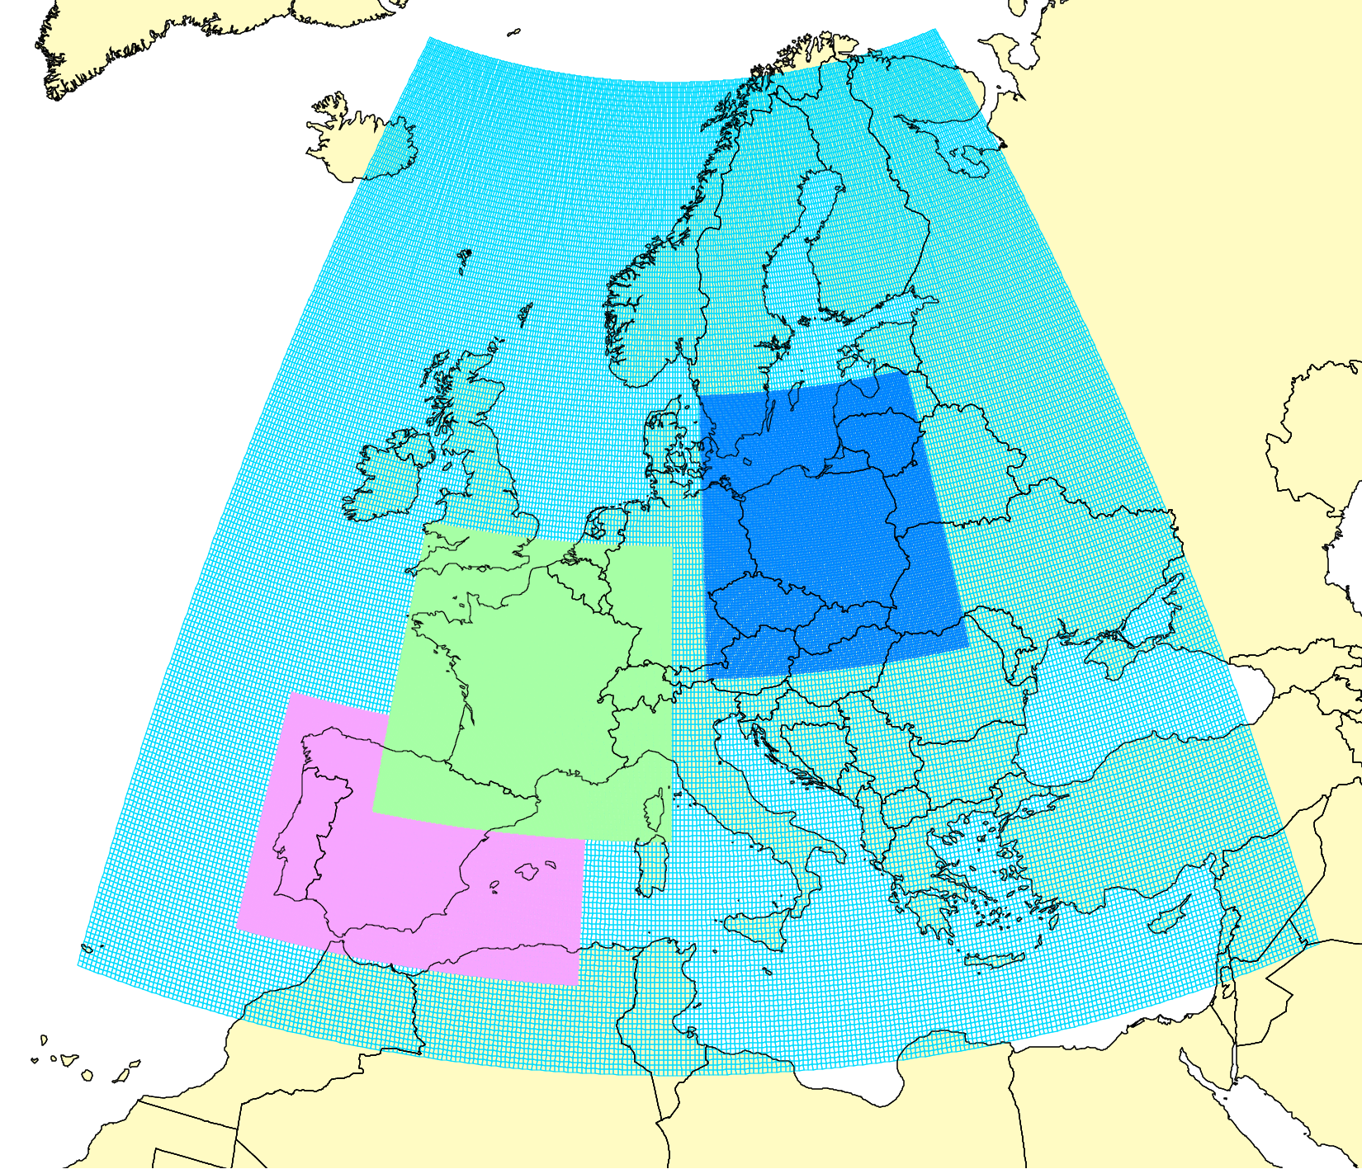
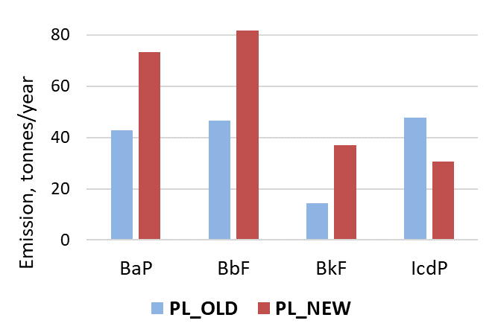
PAH assessment: case studies on PAH pollution
Series of joint research for Spain, France, and Poland to improve PAH pollution assessment
(since 2017 in co-operation with TFMM)
Objectives of case study for Poland:
Evaluation of updated national PAH emission inventory of Poland reported to EMEP (phase I – B(a)P, phase II – other 3 PAHs)
Analysis of PAH pollution levels and exceedances of air quality guidelines in co-operation with national experts
Modelling domains
Poland
France
Spain
Phase II activities:
Analysis and update of model parameterization
for B(b)F, B(k)F, and I(cd)P
Modelling with updated national B(b)F, B(k)F, I(cd)P inventory (PL_NEW) and previous inventory (PL_OLD) for 2018
Analysis of agreement between modelled and observed PAH concentrations using EMEP and EU EEA measurements
Phase II

Slide 9
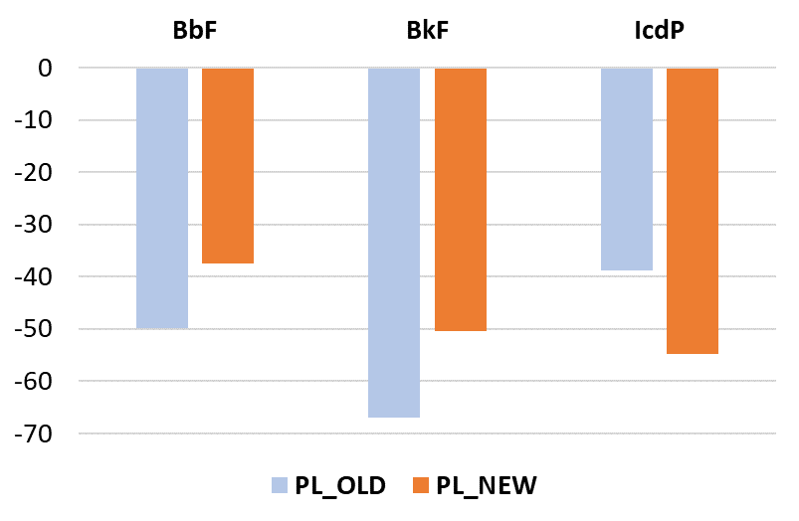
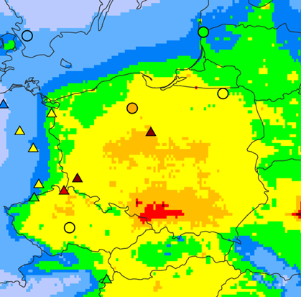
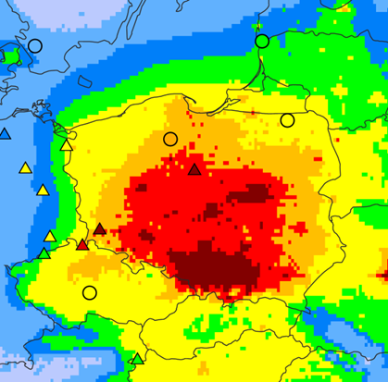
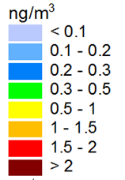
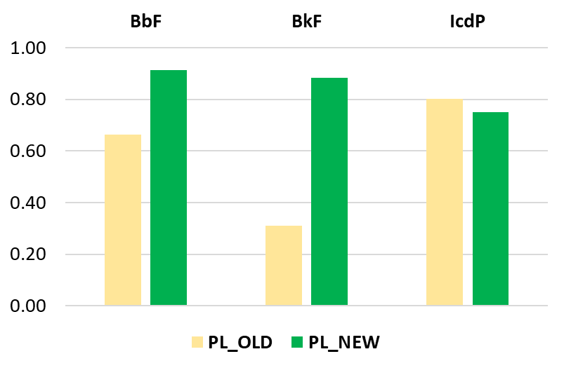
Modelled vs observed PAH pollution levels in Poland
Comparison with data of Background Rural + Suburban stations for 2018 (about 19 stations):
Decrease of model bias for B(b)F and B(k)F, but increase for I(cd)P
Increase of correlation for B(b)F and B(k)F, but decrease for I(cd)P
Increase of Factor of 2 parameter by 30% for B(b)F and B(k)F, but decrease by 10% for I(cd)P
Bias, %
PL_OLD
PL_NEW
Improvement of model results
Correlation
Modelled B(b)F annual mean air concentrations for 2018
Measurements of EMEP ( ) & EEA AQ e-reporting ( )

Slide 10
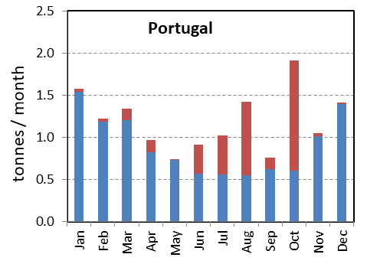
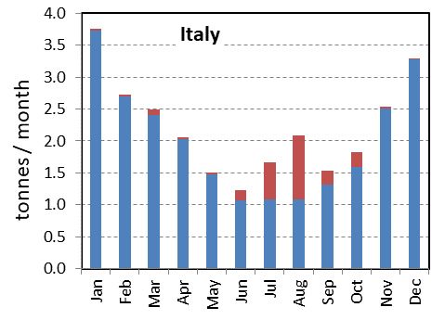
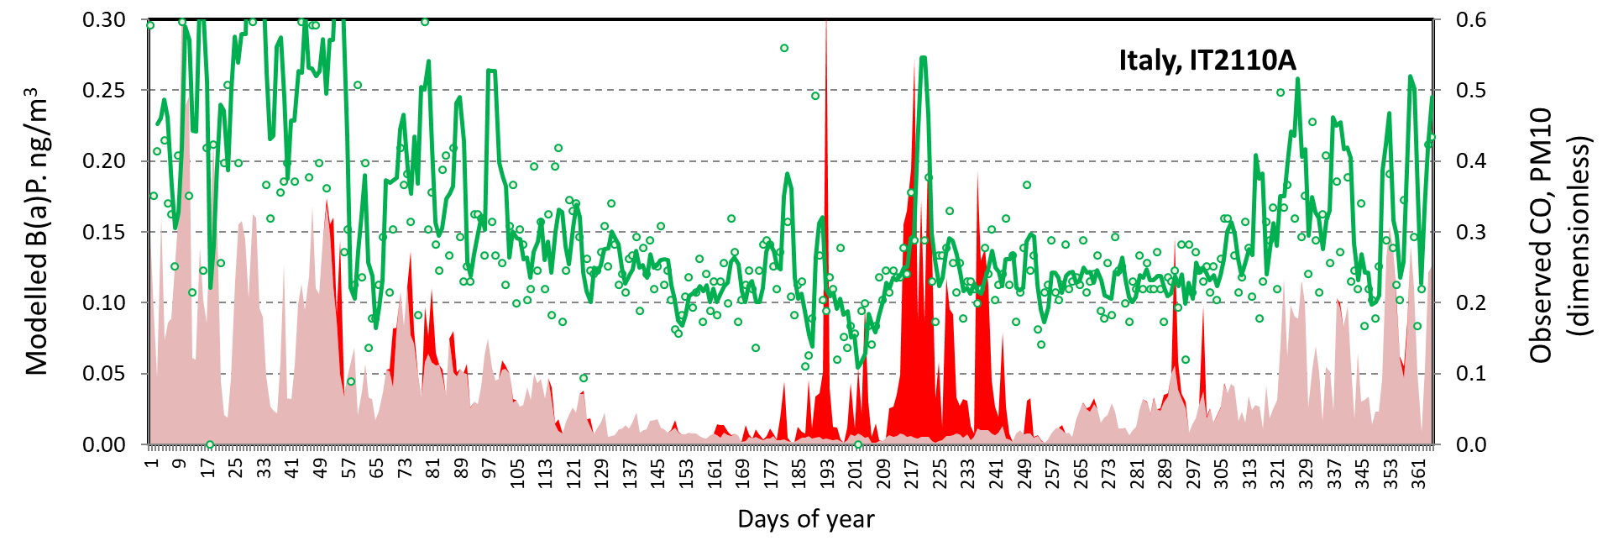
PAH assessment: effect of wildfires on B(a)P pollution
Motivation:
Wildfires are significant source of PM and POP emissions (e.g. PAHs, PCDD/Fs, …)
Importance for the assessment of B(a)P adverse effects on human health
Activities:
Evaluation of B(a)P emissions from wildfires in the EMEP region
Model simulations of the effect of the wildfires on B(a)P pollution levels in the EMEP countries
Anthrop. B(a)P emission
Wildfire B(a)P emission
Preliminary results of inclusion of wildfires:
Increase of annual B(a)P concentrations in southern Europe (5-20%), in Eastern Europe/Central Asia (20-50%)
B(a)P concentration (anthrop. sources)
B(a)P concentration (contribution from wildfires)
Observed CO conc.

Slide 11
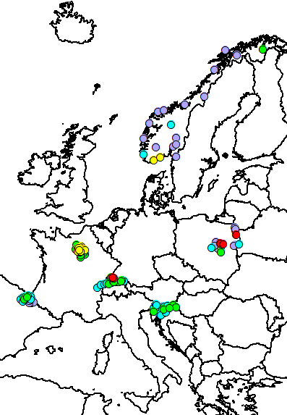
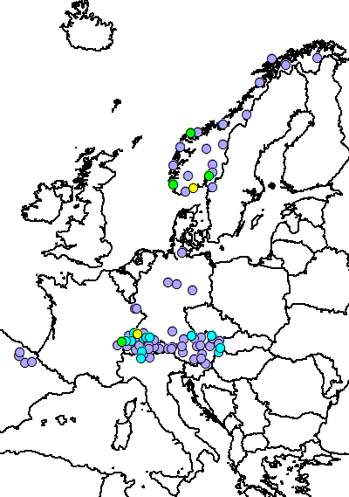
Co-operation with working group on effects (WGE)
Analysis of long-term changes using data of EMEP (observations, modelling) and ICP-Vegetation (moss measurements)
Key features and results:
Use of POP measurements in mosses (B(a)P, HCB, PCBs, PBDE, …) from 2010 and 2015 surveys
Combination of ICP-Vegetation and EMEP data can provide more reliable estimates of pollution changes on local and regional scales
Both moss data and modelled deposition show declining trends of B(a)P in Switzerland and BDE-99 in Norway
Contradicting trends of B(a)P and HCB in Norway
Analysis of discrepancies allows revealing assessment uncertainties (e.g. emission estimates, model parameterizations etc.)
Measured B(a)P concentrations in mosses
Changes between 2010 and 2015 (%)
2010
Model
2015
Moss
Norway
Switzerland
- Modelled deposition flux
< 3
3-5
5-10
10-20
> 20
ng/g
- Concentrations in mosses
Presented at the ICP-Vegetation Task Force meeting (21-23 Feb 2022)

Slide 12
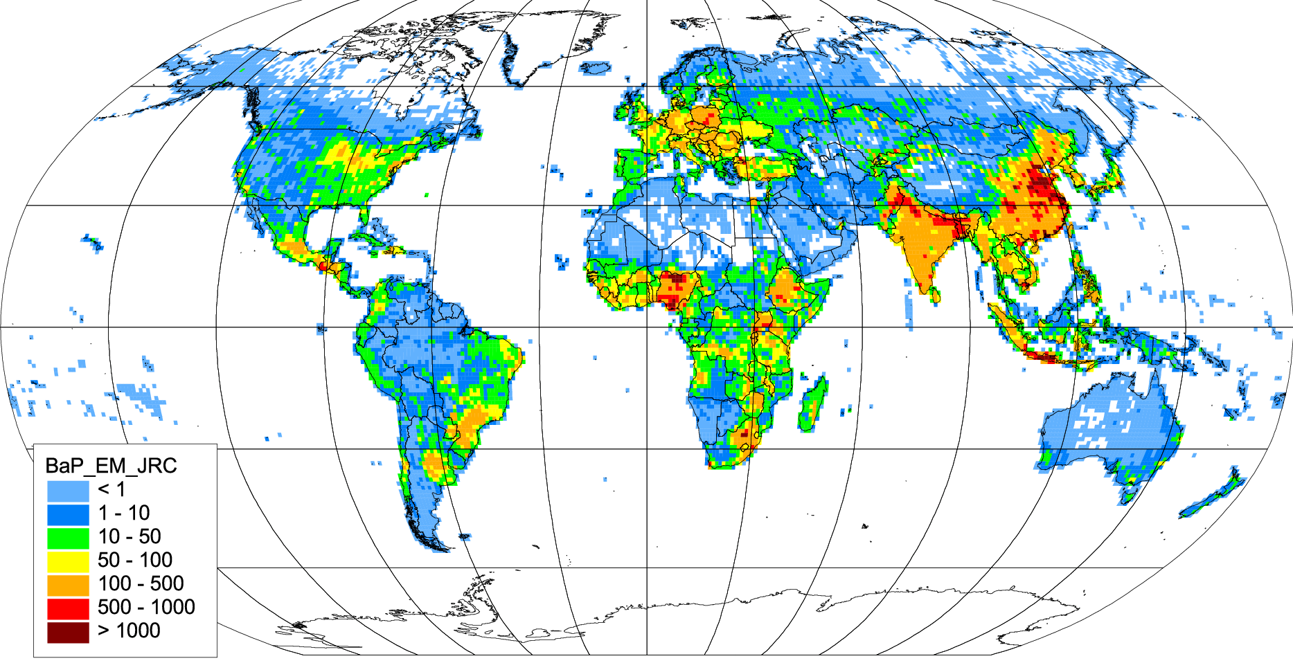
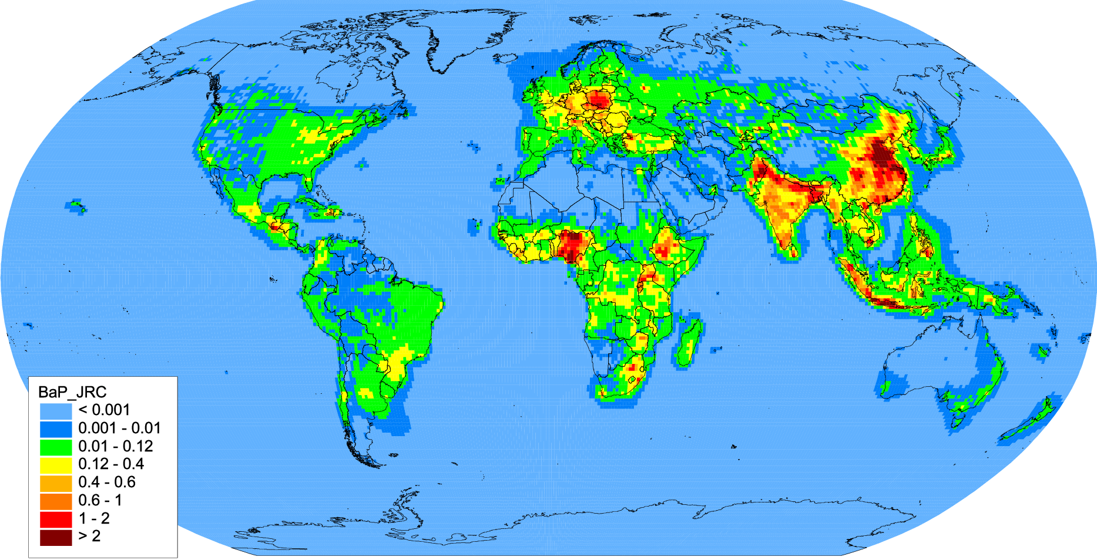
Scientific co-operation on global POP pollution assessment
Contributions to TF HTAP activities on POPs (2021-2022)
Recent and future activities:
Preparatory work for compilation of mosaic emissions of POPs and multi-model experiments
  Release of global scale JRC emission inventory EDGARv6.0_toxPOPs (4PAHs, PCDD/Fs, PCBs, HCB) in April 2022
  Evaluation of JRC EDGARv6.0_toxPOPs emission inventory for B(a)P using GLEMOS model for 2018
TF HTAP virtual meeting on POPs (25 May 2022) focused on global and regional POP/CEC emissions and modelling
  Emissions and atmospheric modeling of PAH and other combustion related substances
  Chemicals of Emerging Concern: sources and multi-media modelling (e.g. PFAS, microplastic)
Contribution to TF HTAP multi-pollutant, multi-model intercomparison exercise focused on the impacts of wild/agricultural fires
(TF HTAP meeting in Nov 2022)
B(a)P emissions, 2018, EDGARv6.0_toxPOPs
Modelled B(a)P based on EDGARv6.0_toxPOPs (2018)
More information on
www.htap.org (TF HTAP)

Slide 13
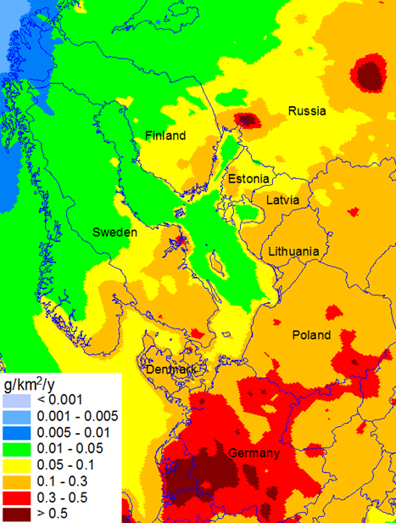
Chemicals of Emerging Concern (CECs)
Contributions to preparatory work for assessment of pollution by CECs (TFMM, TFHTAP)
Motivation:
CECs have confirmed toxicity for humans and ecosystems
Some CECs (e.g. HCBDD, PeCB, PBDEs, PFAS, PCNs and SCCPs) were added to the POP Protocol in 2009
CECs are of high interest of other international bodies (Stockholm Convention, AMAP, HELCOM, OSPAR)
Monitoring of BDE-99 within EMEP
Modelled deposition of BDE-99
Ongoing and future EMEP activities:
Monitoring of CECs at EMEP stations (CCC, countries)
Reviews of information (on emissions, properties, …) and pilot model assessment (MSC-E, HELCOM), included in the Joint EMEP reports for HELCOM (2020, 2021, 2022)
Workshop on CECs measurements and modelling in 2023 (TFMM, TF HTAP, CCC, MSC-E)
2019

Slide 14
Future research directions
(Based on work-plan 2022-2023 and EMEP Strategy)
  Continuation of multi-model intercomparison study of BaP/PM pollution as a part of Eurodelta-Carb study (TFMM) (item 1.1.1.5)
  Collaboration with TF HTAP on development of global POP emissions inventories and model intercomparison studies for combustion related POPs (e.g. PAHs, PCDD/Fs) including effect of wildfires (TF HTAP meetings, Nov 2022) (items 1.1.4.3, 1.1.4.5, 1.1.4.6)
  Co-operation with the effect community on assessment of POP pollution and trends
  (WGE, ICP Vegetation) (items 1.1.1.13, 1.1.1.18)
  Preparatory work for assessment of Contaminants of Emerging Concern (CECs) (item 1.1.1.6)
  Research of atmospheric pollution of the marine environment by POPs and CECs
  (co-operation with HELCOM) (item 1.3.1)

